Slide 1
Warm Up: Read and Summarize
1. Read p. 348-349 in Textbook
2. write a summary of what you read

Slide 3
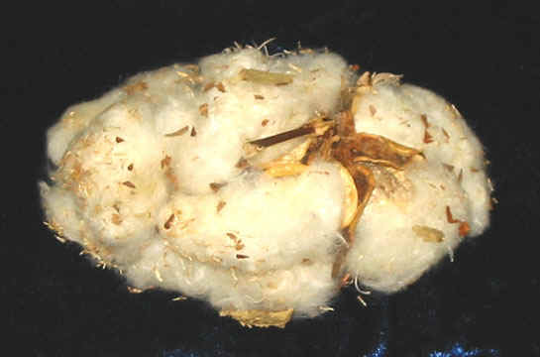
Cotton Gin
· It was difficult to make a profit from cotton because cottonseeds were removed by hand.
Ex.) It took one person an entire day to clean one pound of cotton.
Cotton Ball, picked 1915
Georgia

Slide 4
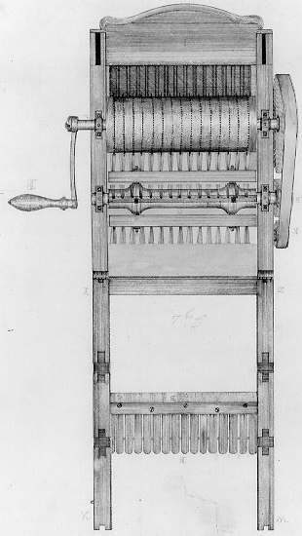
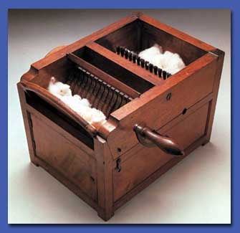
Therefore, Eli Whitney invented the cotton gin in 1793.
Eli Whitney’s cotton gin.

Slide 5
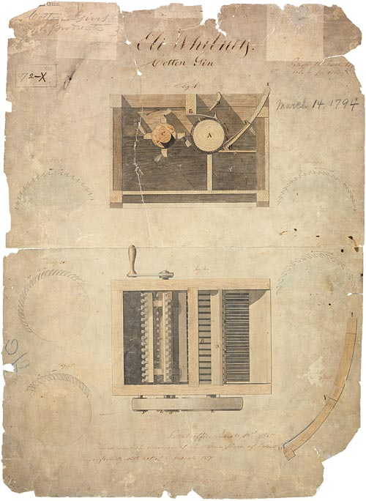
· Whitney applied for a patent on the cotton gin.
· People ignored the patent and built their own.
· Whitney never became wealthy from his invention.

Slide 6
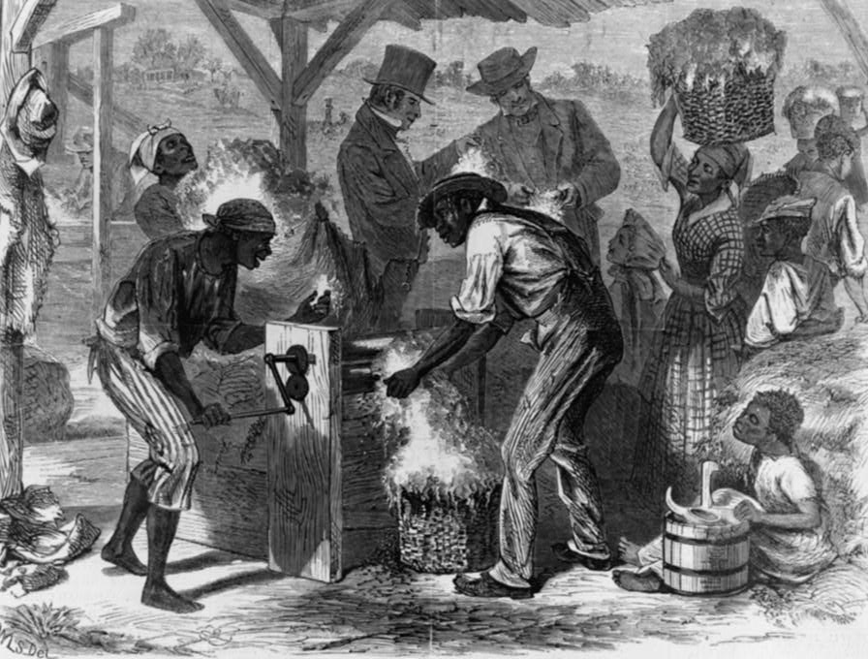
Plantation owners began to earn a lot of money growing cotton.
This caused farmers to increase their dependency on slave labor.
“The First Cotton Gin" (image from 1869)

Slide 7
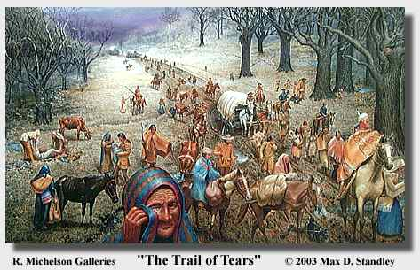
Native American tribes such as the Cherokees and Creeks were forced onto reservations so that farmers would have more land to grow cotton.

Slide 8
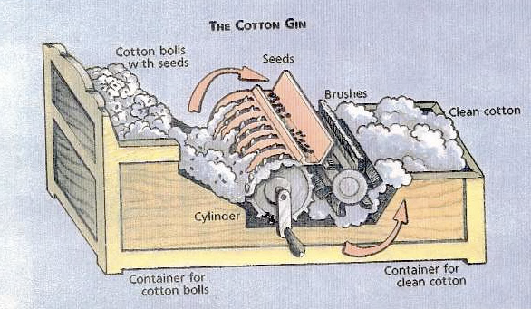
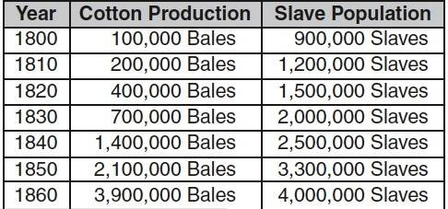
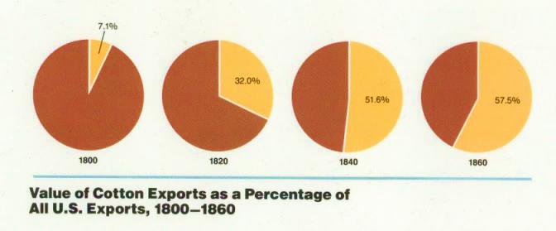
Invented in 1794
(in the United States)
What is the relationship?

Slide 9
The Cotton Gin made it easier to remove cotton seeds.
More plantations began to plant and harvest more cotton which increased the demand for slaves labor.
Cotton production in the South increased to meet the demands of textile factories in the North and abroad (becoming a major export of the United States).

Slide 10
Why is Texas not included in the 1840 United States map?
What part of Texas is slave population the highest in 1840? 1860? Why?
How are the U.S. 1840 and 1860 maps different? Same?
In which states(s) does the U.S. slave population significantly increase from 1840 to 1860?

Slide 11
Slavery in Texas 1840 and 1860

Slide 12
Slavery in the United States 1840 and 1860

Slide 13
Texas and the U.S. 1840

Slide 14
Texas and the U.S. 1860

Slide 15
SEE Report:
Could the expansion of slavery be stopped in 1860? Explain your answer.

