Slide 1
Warm Up: (10 Min) Answer on white paper
Answer the following question in acrostic form:
What does it mean to have a voice in society?
V
O
I
C
E

Slide 2
Bad Romance parody video

Slide 3
Suffrage-The Right to VOTE
Suffrage Movement in the USA
Women’s Rights, 1800’s
People began thinking women should be able to vote, too.
1848 – Women organized a convention in New York.
Called the “Seneca Falls Convention”.
It took 80 years before women would get the right to vote!
Many generations of women (and some men) worked to make this happen

Slide 4
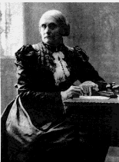
Important Suffragist
I. Susan B. Anthony
Born February 15, 1820 in
Adams, Massachusetts.
Raised in a Quaker family.
Quakers long activist traditions.
Developed a strong sense of justice because of this!

Slide 5
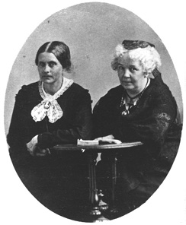
II. Elizabeth Cady Stanton
Met Susan B. Anthony in 1851.
They worked together for the next fifty years!
Stanton wrote and gave speeches.
Wanted improvement of legal and traditional rights for women.

Slide 6
III. Lucretia Mott
Helped organize and call together the 1848 Seneca Falls Convention.
Was a strong supporter of education.
Lucretia Mott Schools – One opened in Indianapolis, Indiana.
Notes:
Background image: 3 cent stamp from 1948 celebrating 100 year anniversary of the beginning of the women’s suffrage movement. Photo url: http://www.entretodas.net/wp-content/2008IMG/EStanton_Catt_Mott_Stamp.jpg. From left: Elizabeth Cady Stanton, Carrie Catt (Lucretia Mott is under her own photo on the slide.)

Slide 7
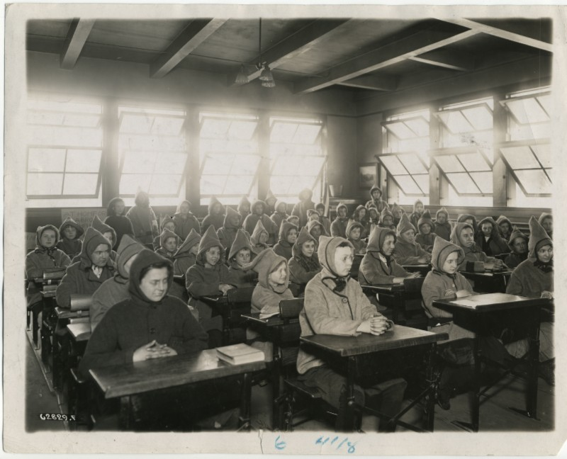
Lucretia Mott “Open Air School”, Indianapolis, Indiana -
Photo is from the 1910’s.
Kept windows open year round to give students “fresh air” and prevent Tuberculosis.
Believed good for their health.
Students also went outdoor a lot for exercise.
Students wearing coats – cold in class!!
Notes:
Background: Photo of Lucretia Mott School 29, Indianapolis, Indiana taken in August, 2011. (The school was having some renovations to the front door and entryway.) Photo url: http://historicindianapolis.com/wp-content/uploads/2011/09/Rural-23-N.-Lucretia-Mott-School-29-Aug-2011.jpg.

Slide 8
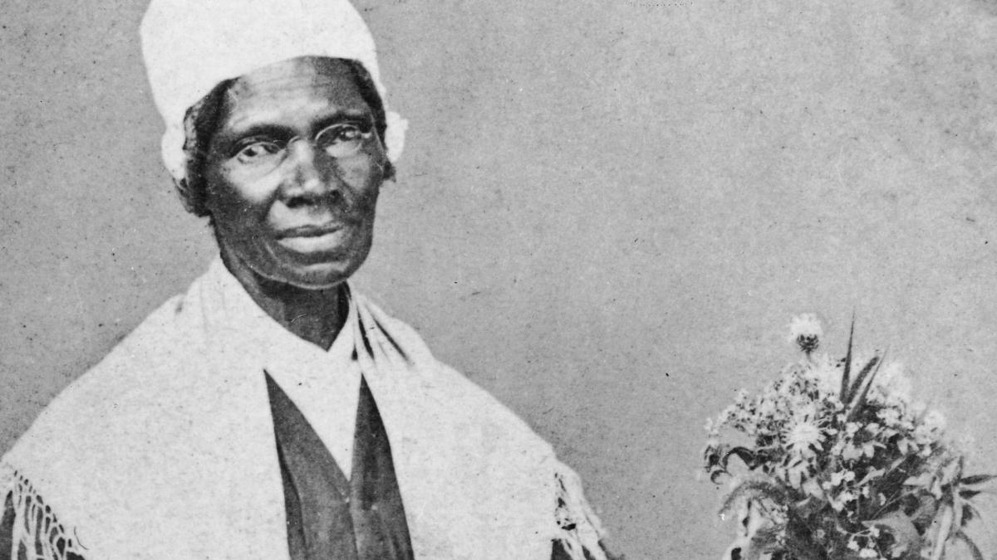
IV. Sojourner Truth
Famous for her work as an “abolitionist” (people who opposed slavery).
Truth started speaking about women's rights after attending a Women's Rights Convention in 1850.
Notes:
Background: Promotional poster for Sojourner Truth’s 1851 Speech at the Women’s Rights Convention in Akron, Ohio (1851). At that convention she gave her famous “Ain’t I A Woman?” speech. Photo url: http://www.sojournertruth.org/images/11-Poster-mini.jpg.

Slide 9
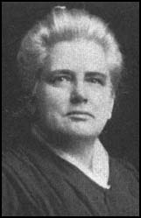
V. Anna Howard Shaw
A doctor as well as the first woman Methodist Minister.
Met Susan B. Anthony in 1888.
Began working for women’s rights.
Was the president of the National American Women Suffrage Association (NAWSA) for 11 years.

Slide 10
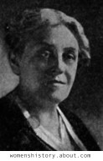
VI. Carrie Chapman Catt
Was president of the NAWSA when the 19th amendment (giving women the right to vote) was passed in 1920.

Slide 11
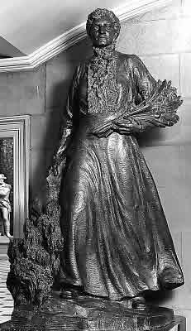
VII. Esther Morris
The first woman to hold public office in the United States.
She was a judge in the Wyoming Territory.

Slide 12
19th Amendment Passed: August, 1920
The right of citizens of the United States to vote shall not be denied or abridged by the United States or by any State on account of sex.
Congress shall have power to enforce this article by appropriate legislation.
***Tennessee was the 36th state to ratify, and it passed by only 1 vote.

Slide 13
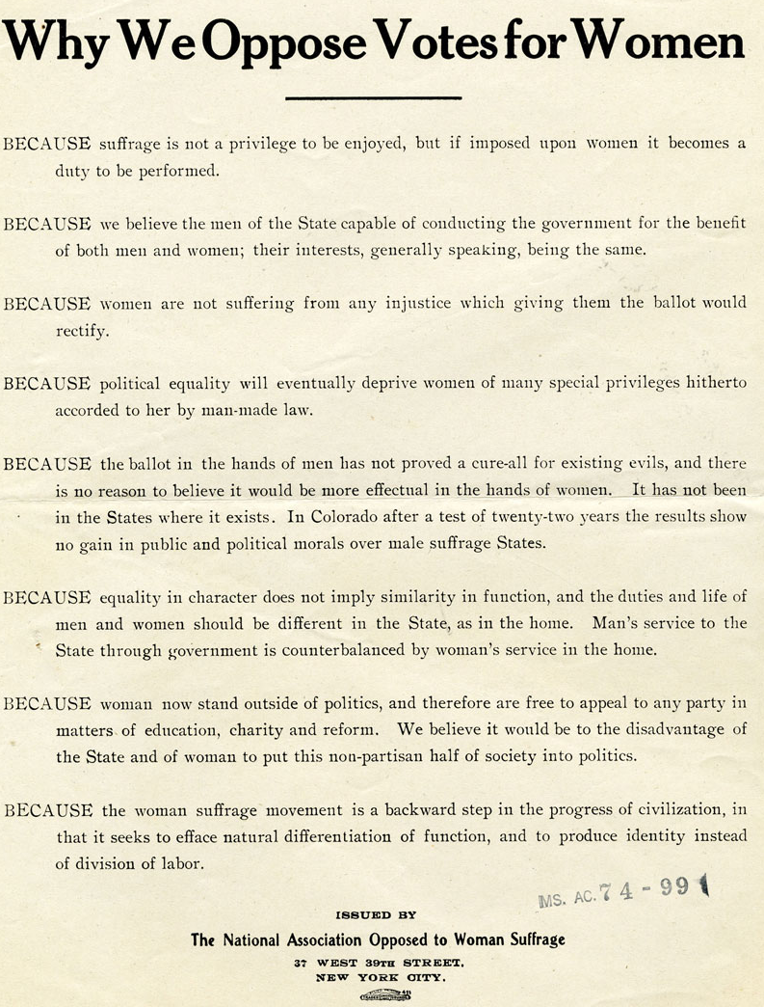

Slide 14
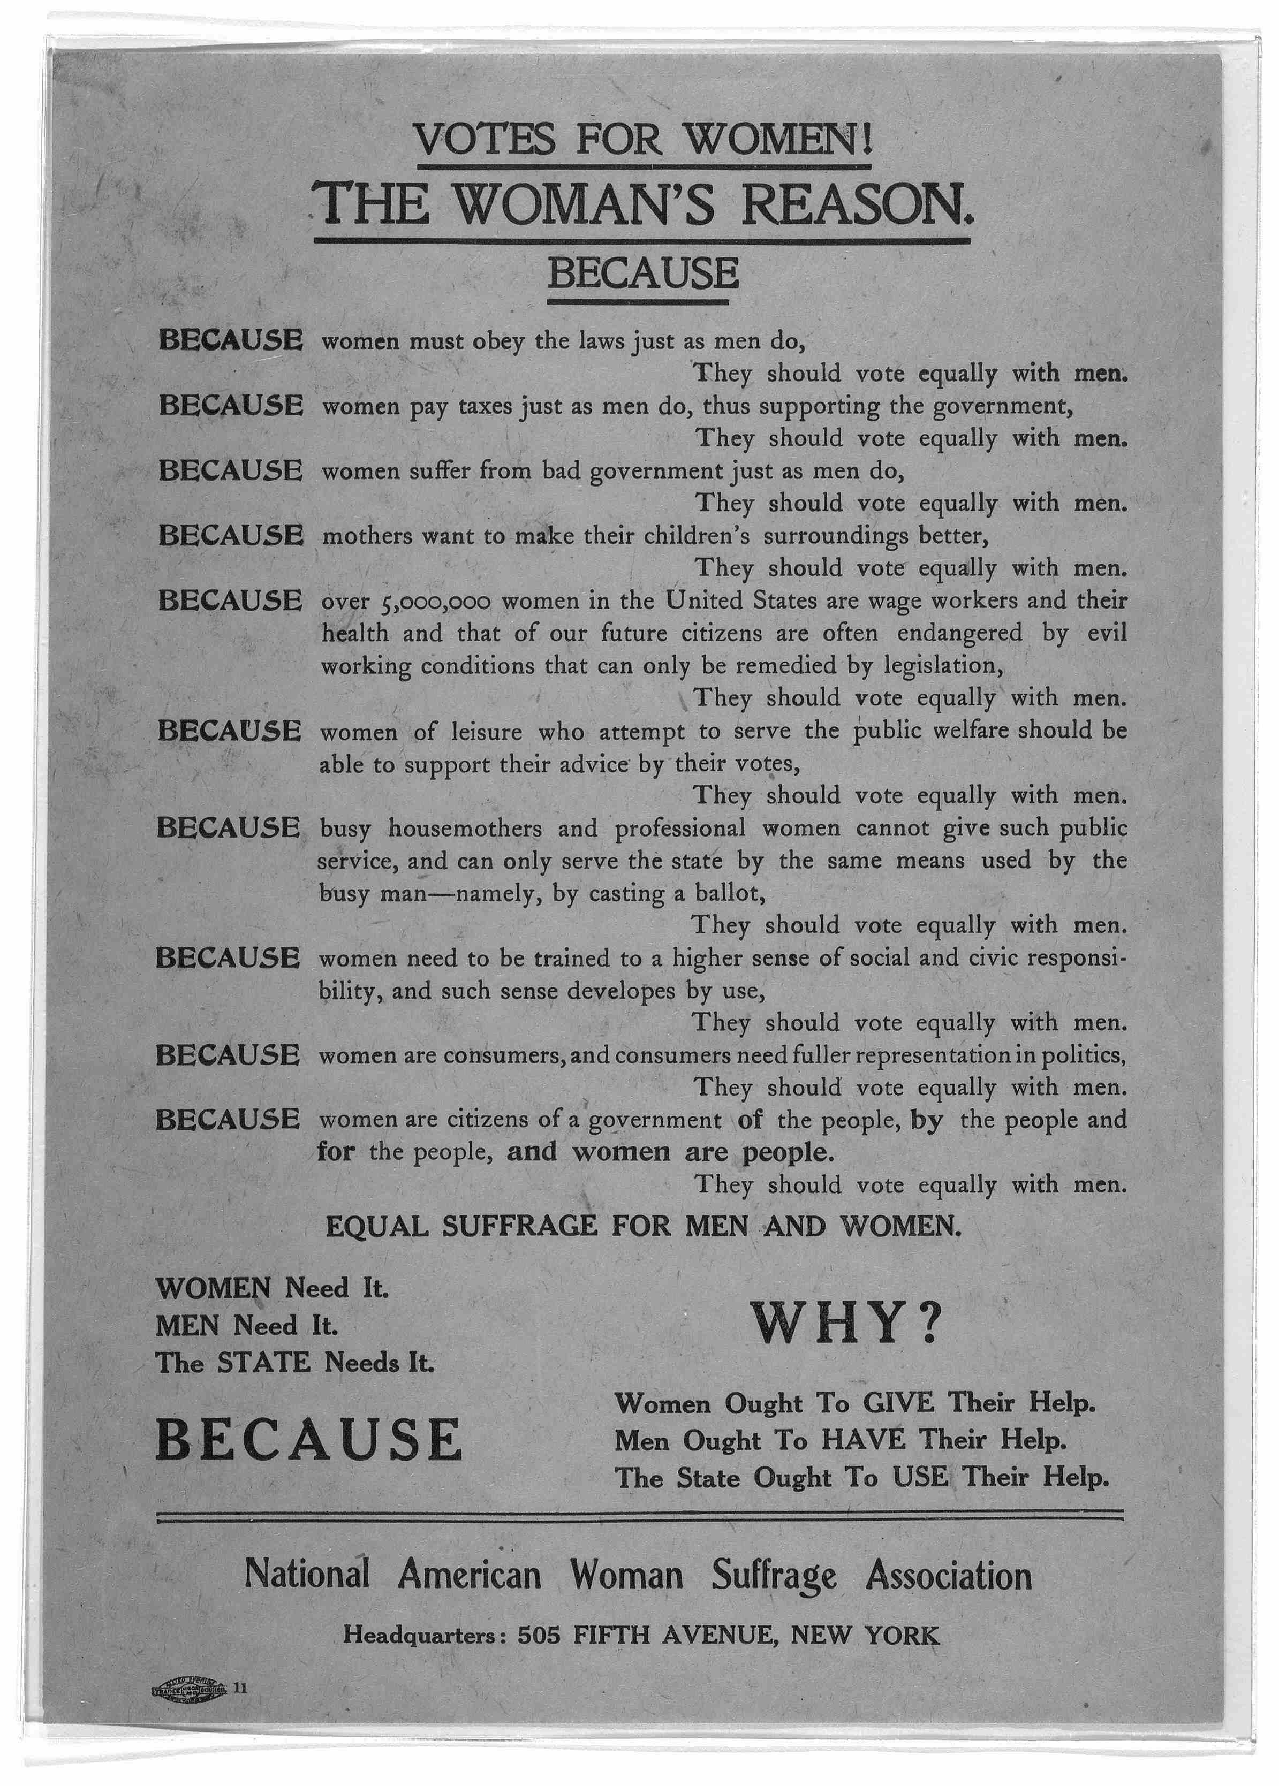

Slide 15
Document 1 –Why We Oppose Votes for Women, 1899 | Document 1 – Votes for Women – The Women’s Reason, 1912
Identify three reasons for not giving women the right to vote? | Identify three reasons for giving women the right to vote?
How does this document describe the process of voting for women? | How does this document describe the process of voting for women?

Slide 16
Document 1 –Why We Oppose Votes for Women, 1899 | Document 1 – Votes for Women – The Women’s Reason, 1912
What is meant by “the woman now stands outside of politics?” | What is meant by “women suffer from bad government just as men do?”
Why was a woman’s duty to the home? | If women workers were able to vote, how powerful would their votes be?

Slide 17
The Suffrage Movement p. 512 | Limits of Reform p.513
1. What role did Texas women play in the Progressive reforms? | 1. How were Texas women divided in their fight for reforms?
2. Describe the importance of Annie Webb Blanton to Texas politics. | 2. How were the actions of Christia Adair and Jovita Idar similar and different?
3. Identify the significant women suffrage leaders in Texas. | 3. How did Texas deny suffrage to minority groups?
4. How did the U.S. Congress address this issue? | 4. How did poll taxes affect African Americans and Mexican Americans in Texas?
5. In what areas did the Women’s Joint Legislative Council focus on after women gaining the vote? | 4. How did Jim Crow laws affect African Americans in Texas?

Slide 18
Revisit your acrostic from the beginning of the lesson.
What changes would you make to it to reflect your new learning?
V
O
I
C
E

