Slide 1
Be Kind DCSD SWAAAC

Slide 2
I can say and do kind things.

Slide 3
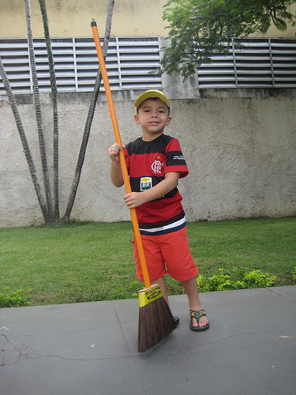
I can help.

Slide 4
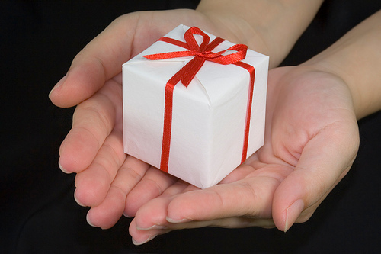
I can give gifts.

Slide 5
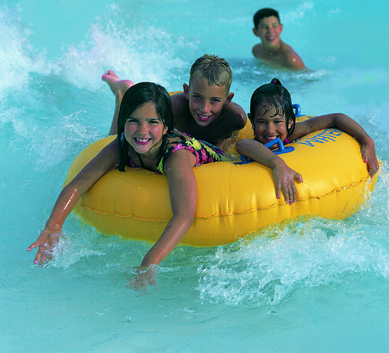
I can share.

Slide 6
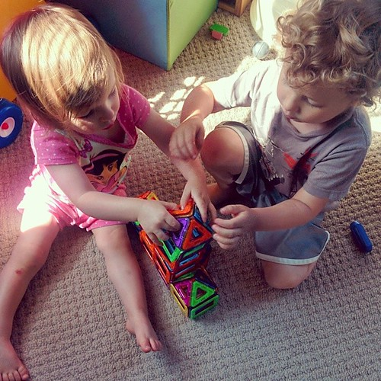
I can play with my friend.

Slide 7
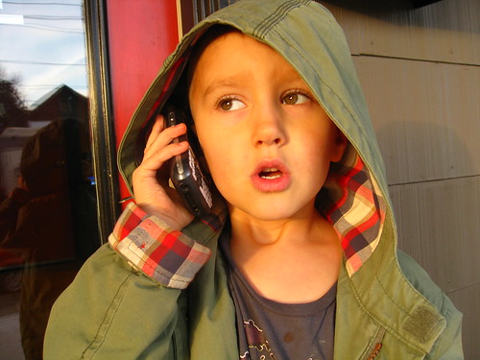
I can be a good listener.

Slide 8
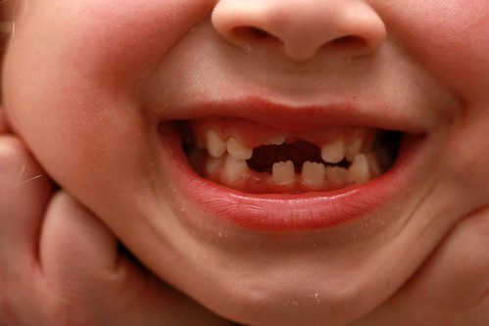
I can smile.

Slide 9
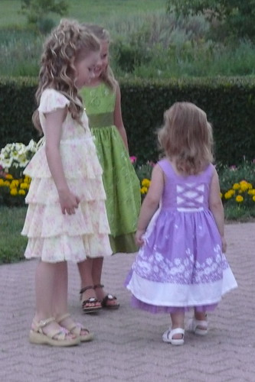
I can say, "You look good!"

Slide 10
I can say, "Thank you."

Slide 11
I can say, "Good work!"

Slide 12
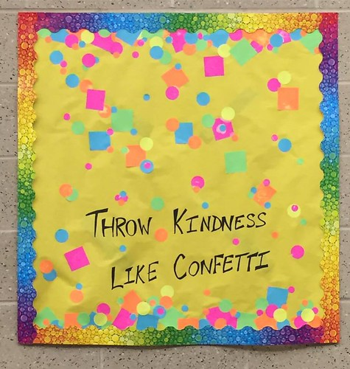
I make people happy when I say and do kind things.

