Slide 1
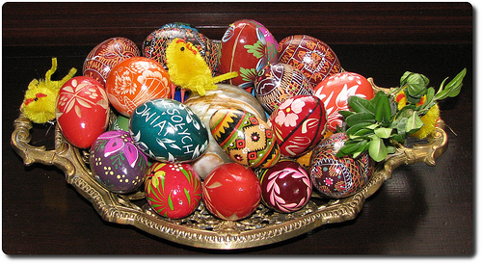
I love Christmas! Jane Farrall

Slide 2
I love Christmas!

Slide 3
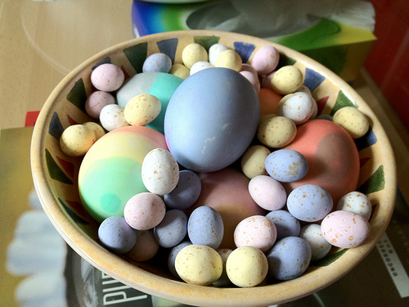
I love Christmas eggs.

Slide 4
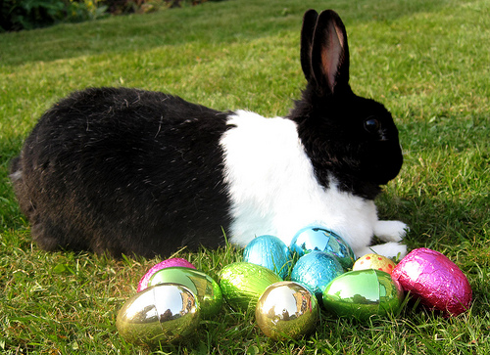
I love the Christmas bunny.

Slide 5
I love Christmas.

Slide 6
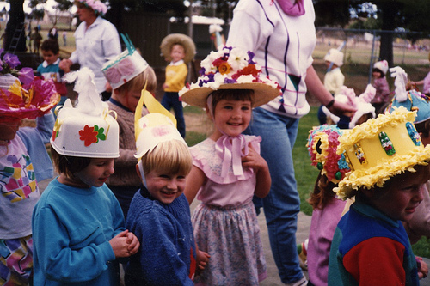
I love Christmas bonnets.

Slide 7
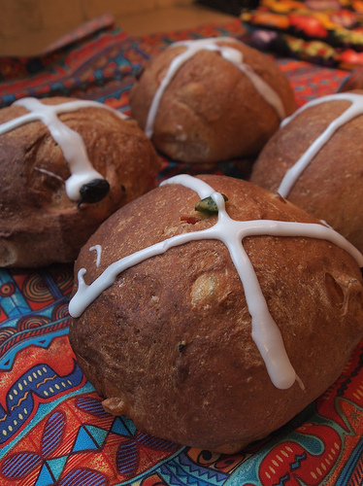
I love Christmas buns.

Slide 8
I really love Christmas.

Slide 9
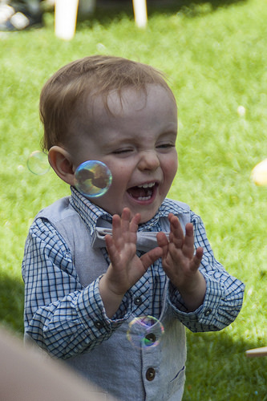
I love Christmas bubbles.

Slide 10
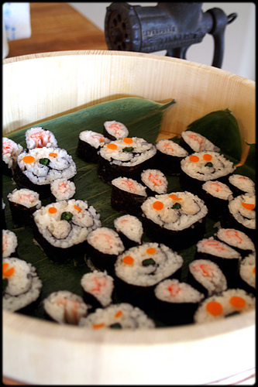
I love Christmas sushi.

Slide 11
I love Christmas.

Slide 12
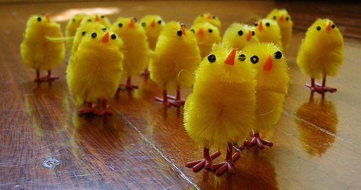
I love Christmas chicks!

Slide 13
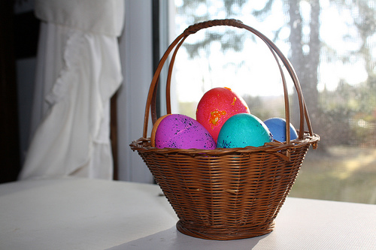
I love Christmas baskets.

Slide 14
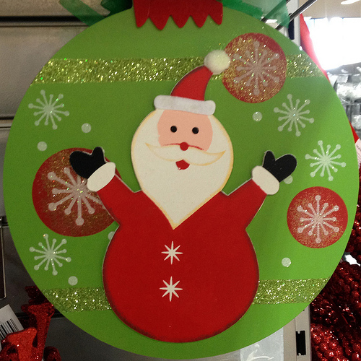
But I think I prefer Easter.

