Slide 1
Vital Link Capstone Experience

Slide 2
MISSON​
Preparing all students for success in college, career and community leadership.​
​
VISION​
All Fort Worth ISD Career and Technical Education students will achieve personal success in their academic and chosen program of study to ultimately obtain their career objectives as working and contributing citizens of society​

Slide 3
CONTENTS
What is Vital Link?
What is Vital Link Capstone?
Where the Best Begins
Capstone Opportunities
Next Steps

Slide 4
What Is Vital Link?

Slide 5
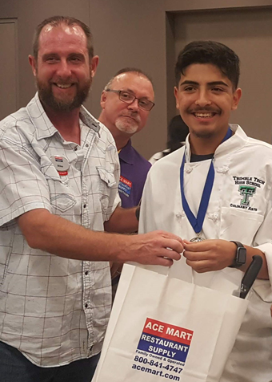
What Is Vital Link?
The FWISD Office of Innovation is undergoing a series of cradle-to-career initiatives to redesign, transform and revitalize local schools.
One of those initiatives is the refreshed and expanded Vital Link – Connecting Students to Careers. Vital Link is a unique business and education partnership program designed to give students and their teachers the opportunity to gain real-world work experience and apply the skills learned at school to the workplace.
Notes:
The Fort Worth Chamber of Commerce, the Fort Worth Metropolitan Black Chamber of Commerce and the Fort Worth Hispanic Chamber of Commerce view collaboration by employers with the school district as a best practice for talent development, attraction and retention.
Other community partners include the City of Fort Worth, Tarrant County College, Workforce Solutions for Tarrant County, Texas Wesleyan University and others.

Slide 6
VITAL LINK AT-A-GLANCE
84,000 Students
83 Elementary schools,
29 Middle schools & 6th grade centers,
18 High schools
16 other campuses Fort Worth ISD enjoys a diverse student population and strong community partnerships.
Under the leadership of Superintendent Kent Scribner and the Board of Education, the District is undergoing a series of initiatives that will Redesign, Transform, and Revitalize Fort Worth ISD Schools.
One of those initiatives is the new Vital Link Connecting Students to Careers. Vital Link is a unique business and education partnership program designed to give ALL students and their teachers the opportunity to gain real-world work experience and apply the skills learned at school to the workplace.
Notes:
These sites helped make VITAL LINK 2019 a success:
Balfour Beatty Construction
City of Benbrook
City of Fort Worth Parks & Community Services
Cook Children’s Medical Center
EECU
Exelon Corporation
Fort Worth Chamber of Commerce
Fort Worth Museum of Science and History
Goodwill Industries of Fort Worth
Linebarger Goggan Blair and Sampson, LLP
Naval Air Station Joint Reserve Base Fort Worth
North Central Texas Council of Governments
Tarrant County College Northwest Campus
Tarrant County College South Campus
Texas Christiam University
Trinity River Authority
Univision
Wells Fargo Advisors

Slide 7
Where the Best Begins

Slide 8
SCHOOL AND BUSINESS LEADERS DISCUSS THE FUTURE OF FORT WORTH
Where the Best Begins
“Where the Best Begins,” is a partnership between Fort Worth ISD, Tarrant County College, and the Fort Worth Chamber of Commerce.
Fort Worth Mayor Betsy Price shares the critical question: How can education and industry work together to meet the workforce needs in a post-COVID world?
Notes:
https://youtu.be/bBO679A20zc
SCHOOL AND BUSINESS LEADERS DISCUSS THE FUTURE OF FORT WORTH AT VIRTUAL SUMMIT
Posted by Fort Worth ISD on 7/27/2020 10:00:00 AM
The June 25 virtual summit, “Where the Best Begins,” was part of a partnership between Fort Worth ISD, Tarrant County College, and the Fort Worth Chamber of Commerce to better understand how education and industry can work together to meet the workforce needs in a post-COVID world. Fort Worth Mayor Betsy Price shares the critical question that the City should ask.

Slide 9
“Variety of course and site options through our gold seal programs of choice/ schools of choice and we’re doubling down on career and technical education. We listen to our industry partners and craft our programs to fill their needs.”​​
Dr. Kent Paredes Scribner​​
Superintendent, Fort Worth ISD​​
At 2019 State of Education​​
Notes:
What is VITAL LINK?
VITAL LINK is a weeklong, half-day internship program designed to demonstrate the connection between what is learned in the classroom and what is needed for success in the workplace. The program began in 1991 and was developed by the American Business Conference’s Task Force. It is based on the principle that students can be motivated to achieve in school if they understand the “link” between academics and job skills.

Slide 10
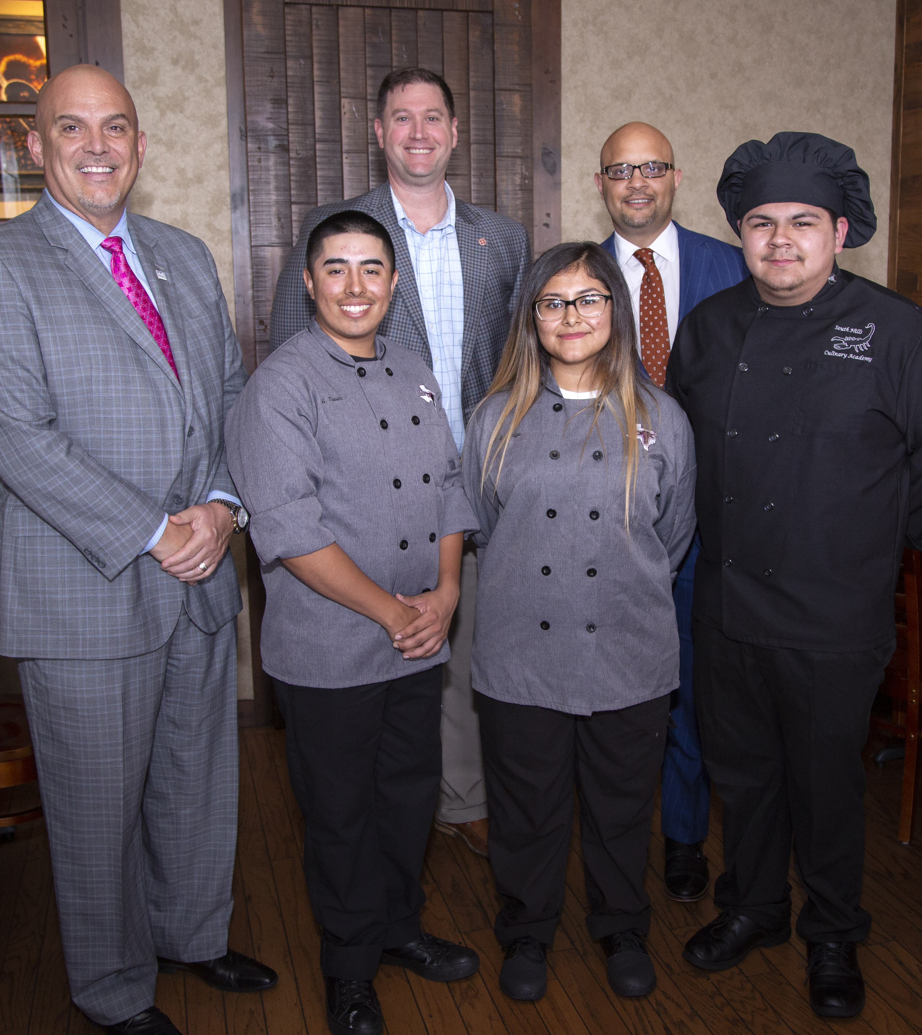
What Is Vital Link Capstone?
Vital link offers a variety of Capstone Experiences to FWISD juniors and seniors, which are intended to improve personal responsibility, workplace habits, and the application of knowledge and skills that are needed to seamlessly integrate students into the workforce, military and/or post-secondary education environment.
The FWISD Vital Link Capstone is a year-long course and learning experience to assist senior students in their preparation for a chosen career field and leads toward industry-based careers and certification.
Kids Fit Menu Invitational Winners: a partnership of Medical City Children’s Hospital, the Greater Dallas Restaurant Association and Texas ProStart
Notes:
Details about each Capstone course are included in the following descriptions. Students and parents are expected to attend a program orientation to discuss further requirements and paperwork​

Slide 11
Capstone Opportunities

Slide 12
CAPSTONE EXPERIENCES
PRACTICUM | CAREER PREPARATION | PROJECT-BASED RESEARCH | DUAL CREDIT
Industry Based Certifications | Industry Employment Experience | Real-world problem solving research | Earn high school and college credit at the same time
See your CTE Coordinator or PSS Coordinator for details about each Capstone course. Students and parents are expected to attend a program orientation to discuss further requirements and paperwork

Slide 13
Fort Worth ISD OFFICE OF INNOVATION

Slide 14
Fort Worth ISD OFFICE OF INNOVATION

Slide 15
Fort Worth ISD OFFICE OF INNOVATION

Slide 16
Fort Worth ISD OFFICE OF INNOVATION

Slide 17
Next Steps

Slide 18
FWISD Vital Link Capstone Partnerships
Notes:
This is presentation shared with potential partners. Campus’ role is to connect with teachers in programs of study for internships and project based learning opportunities.

Slide 19
Agenda
What is Vital Link
2021-2022 Student Capstone Experience Initiative
Programs of Study by Campus
Capstone Overview and Timeline
Industry Partnership Q&A and Support
Next Steps

Slide 20
What is Vital Link
The FWISD Office of Innovation is undergoing a series of cradle-to-career initiatives to redesign, transform and revitalize local schools.
One of those initiatives is the refreshed and expanded Vital Link – Connecting Students to Careers. Vital Link is a unique business and education partnership program with a numerous engagement opportunities. It is designed to support student College and Career Awareness, Exploration, and Real World Application, ultimately satisfying Fort Worth’s need for talent development, attraction, and retention.
Notes:
Vital Link started as a summer program offered to Fort Worth ISD sixth grade students entering the seventh grade in the fall.
This half-day internship program was designed to demonstrate the connection between what is learned in the classroom and what is needed for success in the workplace.
This is a current engagement opportunity now known as Legacy Vital Link.

Slide 21
Vital Link Capstone Experience Initiative
Our goal is to increase our senior capstone offerings across our programs, and are seeking partnerships for our students to receive the following on the job experience and technical training:
Specifically in Science, Technology, Engineering & Math areas
Currently seeking partners for Capstone Experiences to begin FALL 2021:
Internships: Onsite/Virtual/Blended with the industry partner where students are practicing their skills
Onsite/Virtual/Hybrid
Experiences can be Paid and Unpaid
Paid - minimum 10 hours per week
Unpaid - time commitment varies on partner availability
Department rotations, shadowing, after school apprenticeship, clinicals, etc.
Project Based Research: At the campus/virtual/blended, students tackle a real world, work-related problem
Onsite/Virtual/Hybrid
Unpaid
Time commitment varies on partner availability
Mentorship, Entrepreneurship, Service Learning, etc…
Notes:
2021-22 School Year August 16, 2021 - May 27, 2022 (37 Weeks) (e.g. rotations through several companies, rotations through individual departments within one company, individual mentorship between industry and student, or project-based capstone or series of capstones with an industry partner(s)): Projects that the company has worked on previously and can release for public viewing
Current projects of the company that can students can listen in on/learn more about
Departments of the company that also have openings or are not easily filled (e.g. accounting and finance, cybersecurity) in which students can rotate/learn from individuals
Departments that have human capital available for dedicated mentorship and what their general duties include
Previous content and skills students have mastered through previous coursework
Software students have practiced and have a skill set within
Software that students should have more practice using
Sample PBR Capstone Timeline
October: Proposal
January: Research/Fieldwork Log
April: Reflection Essay
May: Presentation

Slide 23
2021-2022 REVISED FWISD Vital Link Capstone Internship Timelines
FOR PAID INTERNSHIPS:
APRIL*: Employer publicizes positions available
APRIL*: Students apply to positions
APRIL*: Employer determines a list of students to interview for position(s) available
Mid to Early May: Employer interviews students
Early to Mid-May: Employer selects and contacts applicants for hire
Mid to Late May: Employer works directly with interns to complete all hiring paperwork and action items (e.g. fingerprinting, drug screening, I-9 forms)
Late May: Teacher informs campus of students in paid practicum for scheduling purposes
Late August to Early September: Interns attend on-boarding day/half-day and begins regularly-scheduled intern hours thereafter
May (Following Year): Interns finish academically-tied internship although students may continue internship should the company and student mutually decide to continue
* Process similar for unpaid and Project Based Research with assistance with teacher for best student/partner matching

Slide 24
Industry Partnership Q & A
What do you see as the best option for your organization today?
Program Areas of Support
Types of Potential Opportunities
Numbers of Potential Opportunities
Capstone Logistic Details: https://www.fwisd.org/Page/25709

Slide 25
Next Steps
Daphne Rickard – Executive Director
Daphne.rickard@fwisd.org
Mary Helen Hill – Coordinator
Maryhelen.hill@fwisd.org
Next meeting
Action Items
Follow up Information
817.814.1510
VITALLINK@FWISD.ORG
WWW.FWISD.ORG/VITALLINK

Slide 27
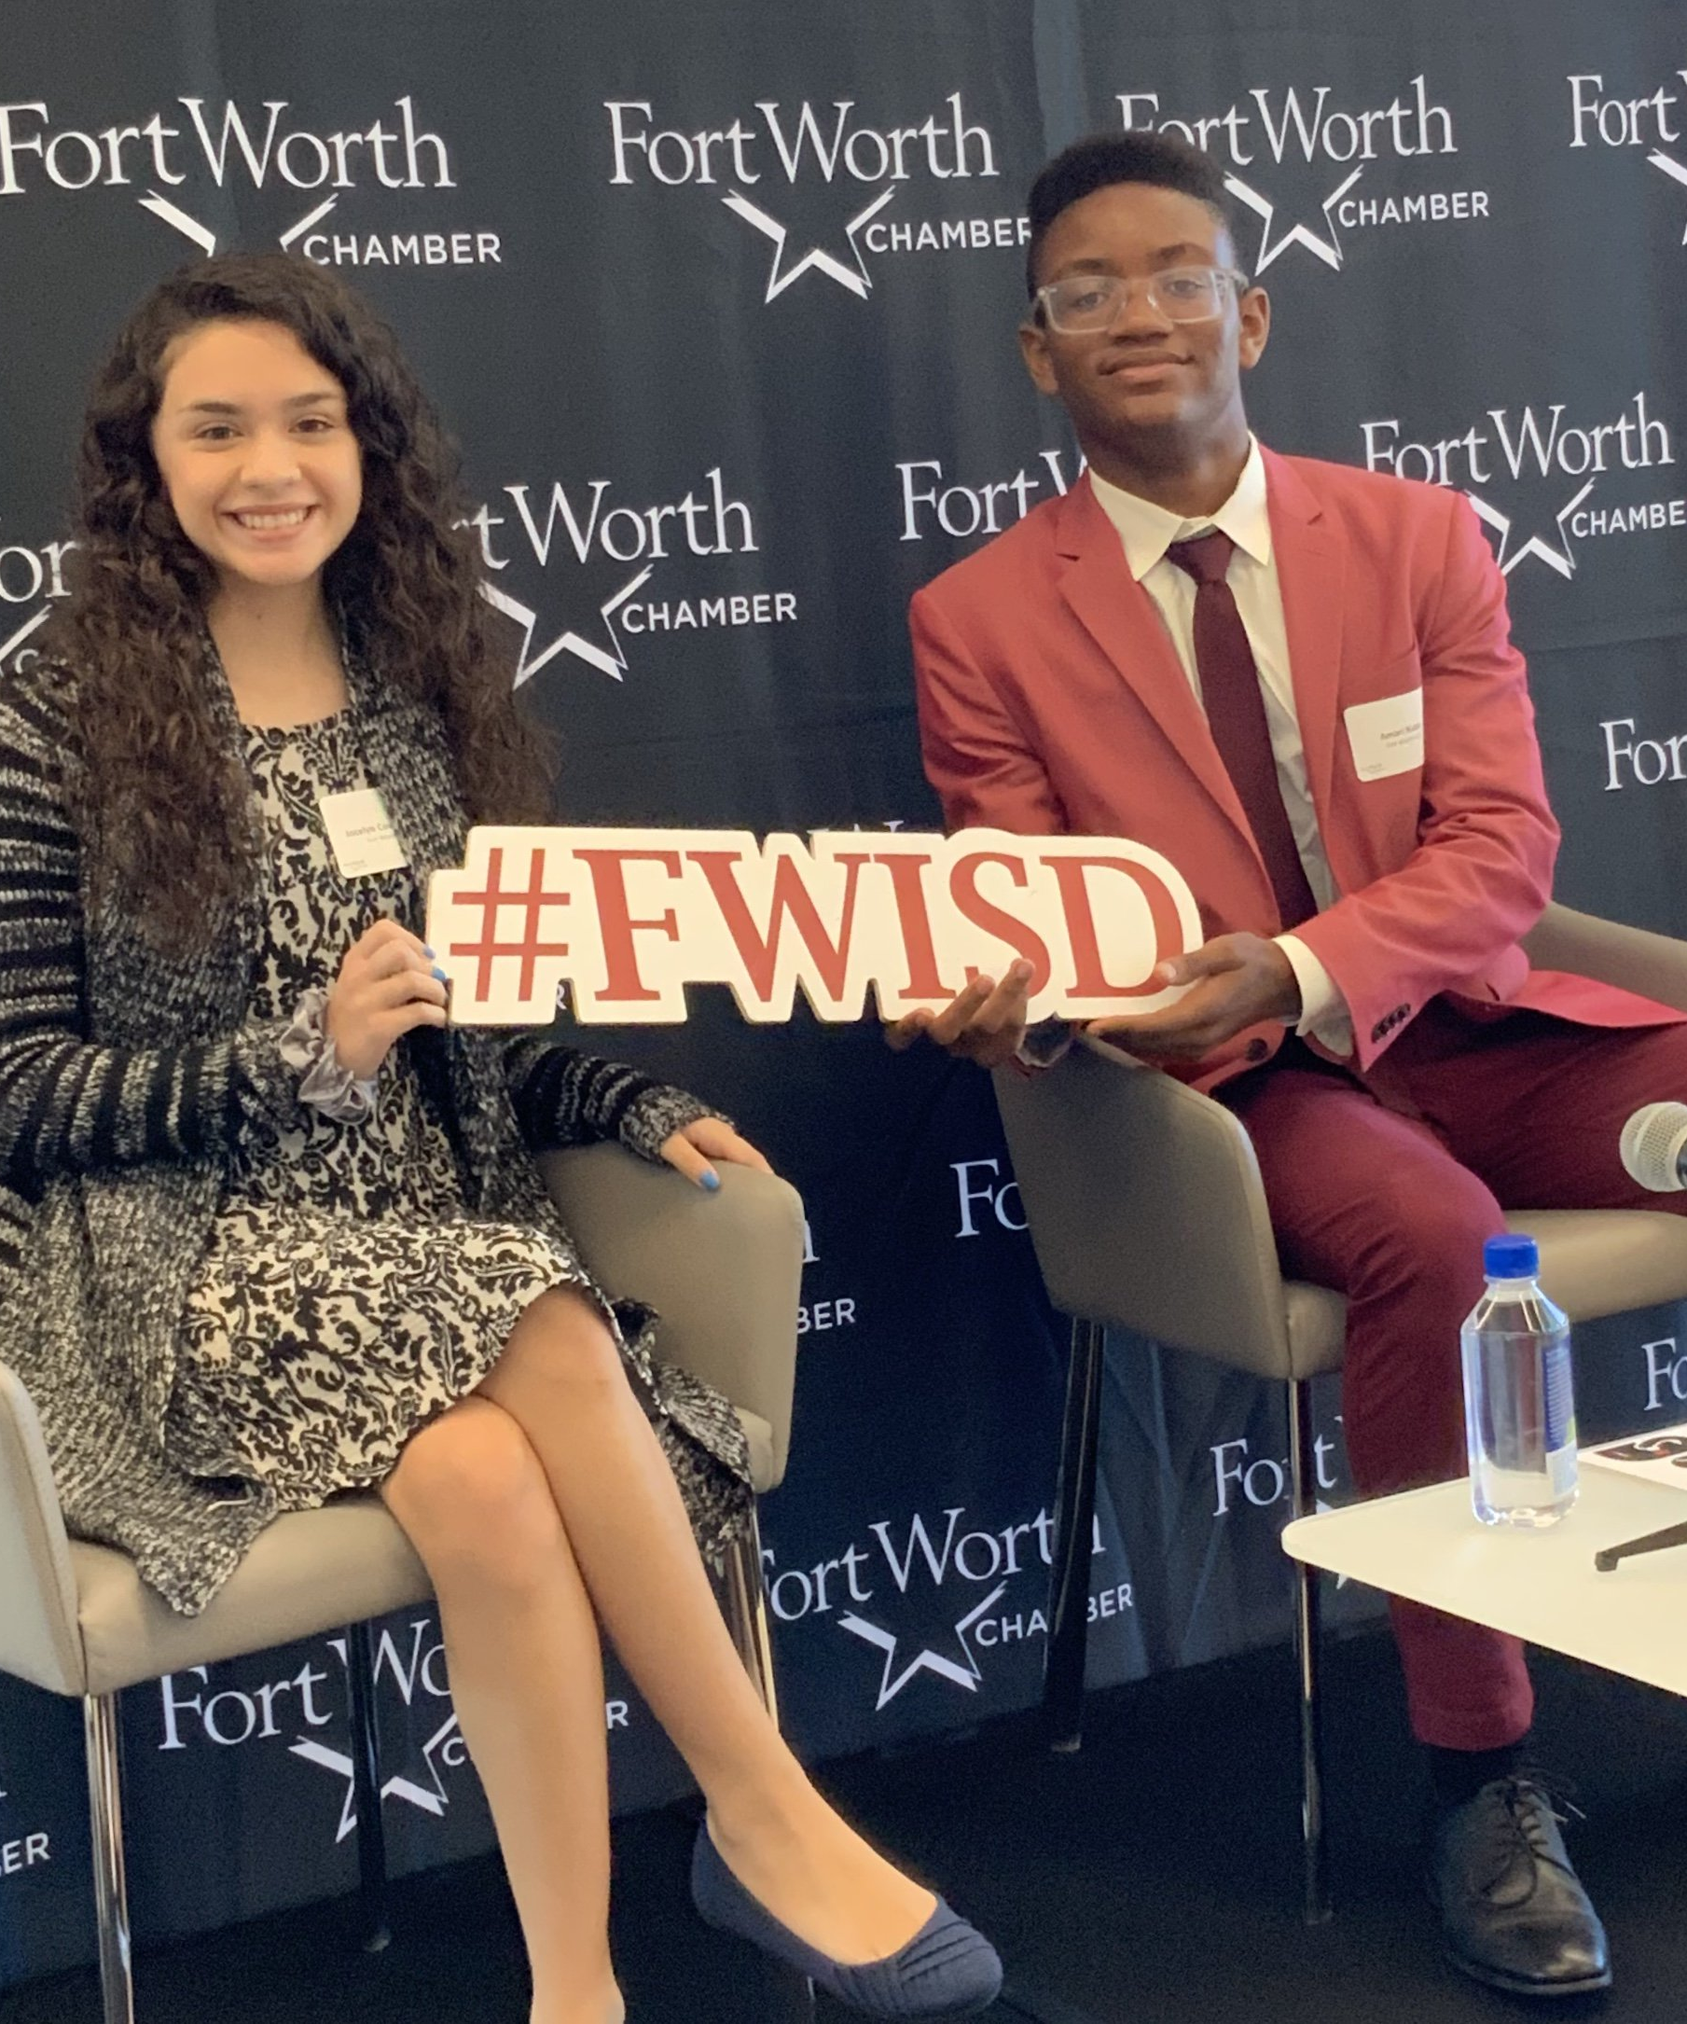
BE PART OF THE VITAL LINK!
See your CTE or Campus PSSS Coordinator for next steps!
Notes:
See your CTE Coordinator or PSS Coordinator for details about each Capstone course. Students and parents are expected to attend a program orientation to discuss further requirements and paperwork

Slide 28
Be THE VITAL LINK!
CONNECT WITH US
Fort Worth ISD OFFICE OF INNOVATION
1050 BRIDGEWOOD DRIVE, FORT WORTH, TX 76112
P: 817.814.1510
VITALLINK@FWISD.ORG
WWW.FWISD.ORG/VITALLINK

