Slide 1
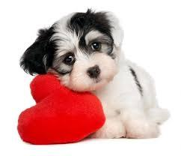
Valentine's Day CLSroom11
Let’s give

Slide 2
Happy Valentine's Day!

Slide 3
Each year we celebrate Valentine's Day on February 14th.

Slide 4
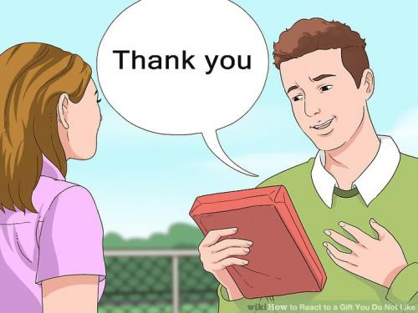
Some friends and family like to give gifts to each other.

Slide 5
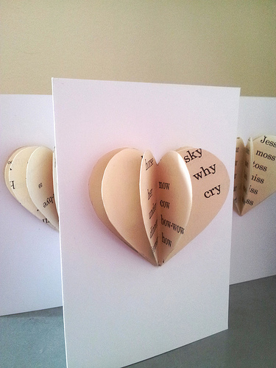
Some people give Valentine's Day cards to friends and family.

Slide 6
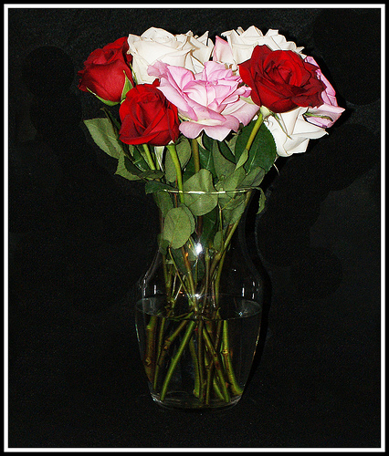
Some people give flowers.

Slide 7
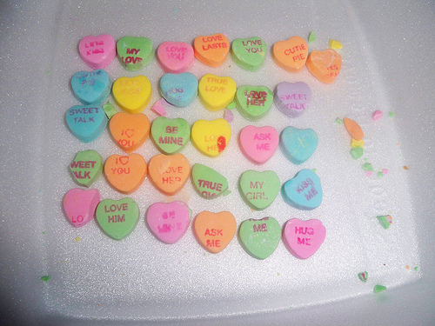
Some people give heart candy.

Slide 8
Some people give valentine's cookies.

Slide 9
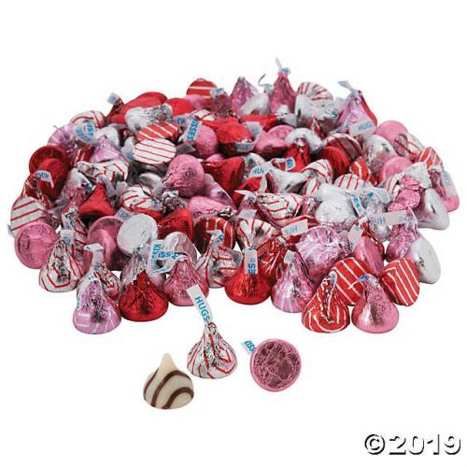
Some people give chocolate hugs and kisses.

Slide 10
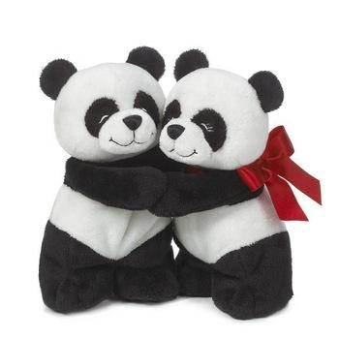
Some give real hugs and kisses.

Slide 11
Giving presents to someone special is one way to show you care.

Slide 12
What will you give?

