Slide 1
Wrangling in the Travel Process
August 8, 2023

Slide 2
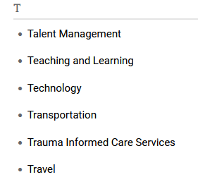
Where to find Travel Information
Go to Departments
Then Travel

Slide 3
Select Travel Forms

Slide 4
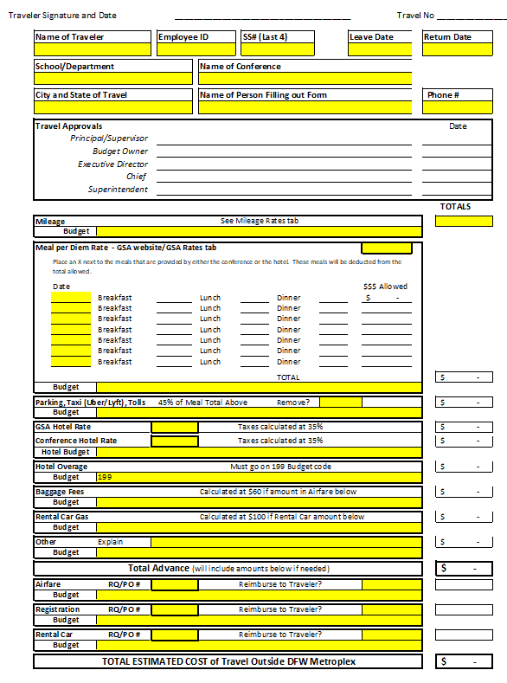
New Cost Estimator

Slide 5
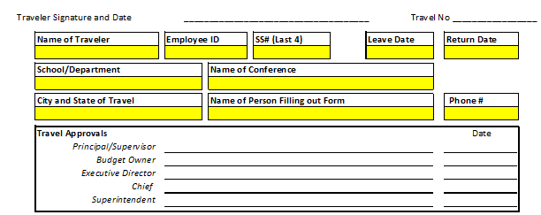

Slide 6
Filling out the 910 Form
Name of Traveler
Employee ID
Last 4 of Social Security Number
Travel Dates
School/Department
Name of Conference
City and State of Travel
Name of Person Filling out the Form
Phone Number (of the person filling out the form)

Slide 7
Signature Process
Will stay the same as current
Please make sure that Procurement only gets ONE copy

Slide 8
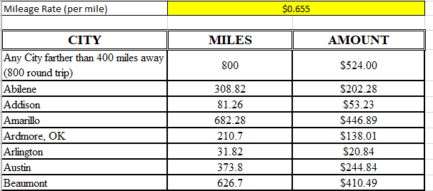
Mileage

Slide 9
Mileage
From the Cost Estimator, go the Mileage Rates Tab
Find the destination city/airport
Use the figure from the Amount column in the TOTALS box
Fill in the budget code for the mileage amount

Slide 10
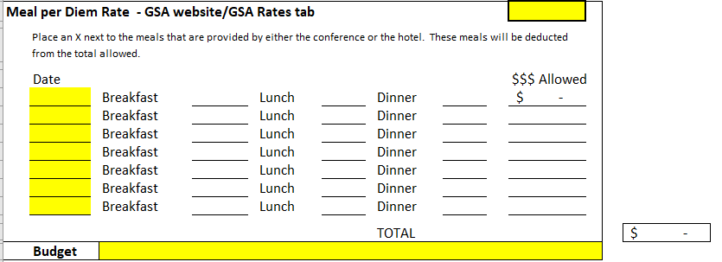
Meal per Diem Rate

Slide 11
Meal per Diem Rate
Use the M&IE Rate
If the City/County isn’t listed, please use the Standard CONUS Rate
Find the State then the City (or County)

Slide 12
Meal per Diem Rate
Go to the GSA Rates tab
Find the destination State and City (or county)
If the city or county isn’t listed, please use the standard CONUS rate
Enter the M&IE Rate into the Meal per Diem Rate Box
Enter the dates of travel (day by day) under Date
Place an X next to an meals that are provided by the conference/class/hotel
Continental breakfast is considered a meal
Fill in the budget code – you can copy and paste

Slide 13
Parking, Taxi, Tolls
Taxi includes Uber/Lyft
Automatically calculated at 45% of meals
Can be removed by typing Yes in the Remove? Box
Fill in the budget code – you can copy and paste

Slide 14
Hotel

Slide 15
Hotel
Start by entering the GSA hotel rate into the GSA Hotel Rate box
From the Lodging Rate column on the GSA Rates tab
The form automatically calculates the taxes (at the GSA rate) at 35%
If the conference rate is higher than the GSA Rate, then enter the conference rate in the Conference Hotel Rate box
Conference proof must be provided with the Cost estimator
The form automatically calculates the taxes at 35%
Fill in the budget code – you can copy and paste

Slide 16
Hotel
If the Conference hotel rate is higher than the GSA rate, the Cost Estimator will automatically calculate the hotel overage
A 199 budget MUST be provided for the hotel overage
Local (199) funds may only be used for the portion that is over the GSA rate, if any
Only allowed for the maximum documented conference rate
The form will only use the higher hotel amount

Slide 17
Hotel
In the event that a conference hotel rate exceeds the allowable rate, travelers are required to reimburse the District the difference between the hotel rate and the allowable rate if conference hotel rate confirmation documentation is not provided to the Purchasing department.
From the Travel Manual:
Hotel advance/reimbursement shall be for actual conference/convention rates at designated conference/convention hotels or for the most reasonable accommodations available pursuant to District practices and procedures and in accordance with the Texas Comptroller of Public Accounts (Texas Mileage Guide).
Unauthorized or disapproved costs and expenses incurred by an employee become the sole responsibility of that employee and shall not be paid or reimbursed by the District. The final approval or disapproval of the business office may be reviewed by the Superintendent or designee(s).

Slide 18
Hotel
Example: The traveler is attending a conference in Houston:
GSA Rate – federal/state government rate = $135
Conference Rate – rate contracted by the conference/convention with a hotel = $215
Rate Paid – the amount over the maximum documented conference hotel rate = $265
If the traveler does not provide conference/convention documentation, the traveler will owe for the amount over the GSA Rate - $80 + $50 per night plus applicable taxes. If it is a documented conference/convention hotel, the traveler will owe $50 per night plus applicable taxes.

Slide 19
Baggage Fees and Airfare

Slide 20
Baggage and Airfare
If the District has paid for a traveler’s airfare, please put the RQ/PO number in RQ/PO box and fill in the amount box
This amount should include the $12.79 travel agent fee
If the traveler needs to be reimbursed for the airfare cost, please type Yes in the Reimburse to Traveler Box
Fill in the budget code – you can copy and paste
Once the amount is in the Airfare box, the Baggage fee will automatically calculate at $60.00
Fill in the budget code – you can copy and paste

Slide 21
Rental Car and Rental Car Gas

Slide 22
Rental Car and Rental Car Gas
If the District has paid for a traveler’s rental car, please put the RQ/PO number in RQ/PO box and fill in the amount box
If the traveler needs to be reimbursed for the rental car cost, please type Yes in the Reimburse to Traveler Box
Fill in the budget code – you can copy and paste
Once the amount is in the Rental Car box, the Rental Car Gas fee will automatically calculate at $100.00
Fill in the budget code – you can copy and paste

Slide 23
Registration
If the District has paid for a traveler’s registration, please put the RQ/PO number in RQ/PO box and fill in the amount box
If the traveler needs to be reimbursed for the registration cost, please type Yes in the Reimburse to Traveler Box
Fill in the budget code – you can copy and paste

Slide 24
Cost Estimator
It is important that all sections are filled out completely and correctly
Forms filled out incorrectly and forms with missing information will cause delays in processing
Budget Account Numbers
Ensure the budget number is correct and complete
Ensure the budget number is strung
Ensure funds are available in the budget

Slide 25
Information to include with the Cost Estimator
Cost estimator
Conference hotel proof
Conference agenda

Slide 26
Other Travel Forms
No changes have been made for Student or Athletic travel yet

Slide 27
Questions?

Slide 28
THANK YOU!

