Slide 1
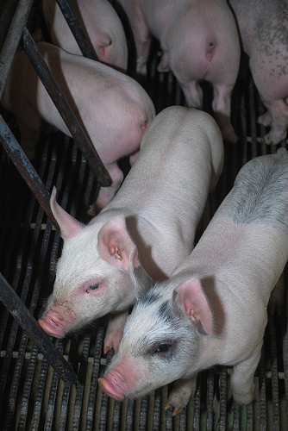
Animals Go In Ms. Ownby

Slide 2
Pigs go in the barn.

Slide 3
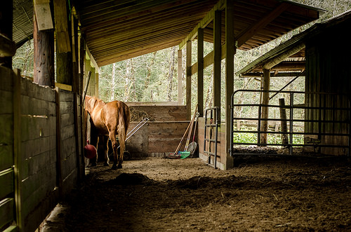
Horses go in the barn.

Slide 4
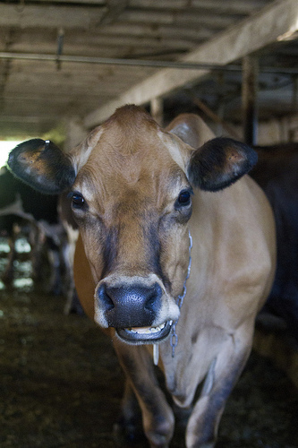
Cows go in the barn.

Slide 5
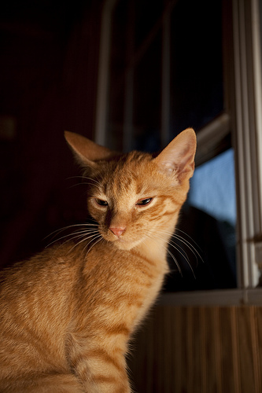
Cats go in the barn.

Slide 6
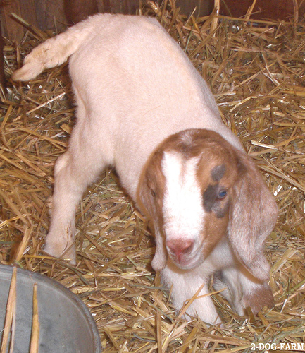
Goats go in the barn.

Slide 7
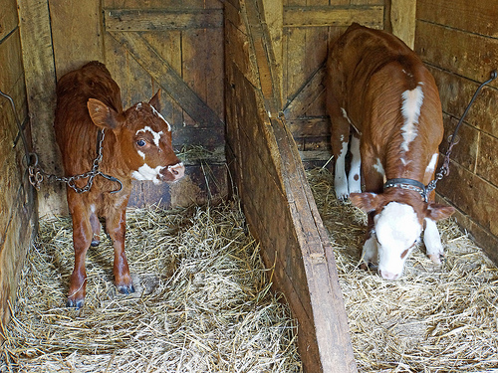
Calves go in the barn.

Slide 8
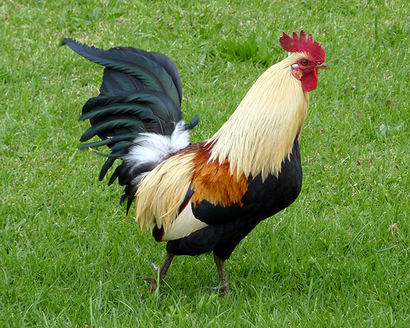
Roosters go in the grass.

Slide 9
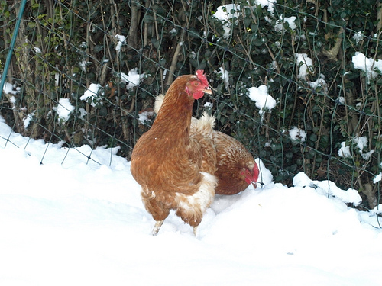
Chickens go in the snow.

Slide 10
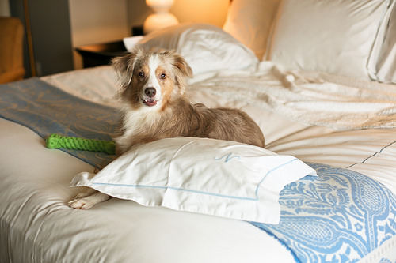
Dogs go in the bed!

