Slide 1
Animals: IN OUT ON OFF
By Kellie Cullen, M.S., CCC-SLP

Slide 2
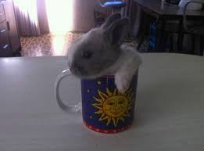
Animals go in

Slide 3
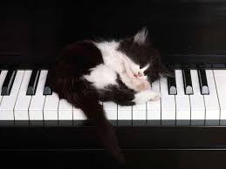
Animals get on

Slide 4
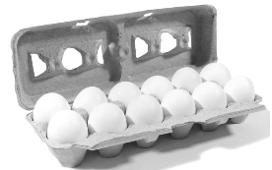
Animals get out

Slide 5
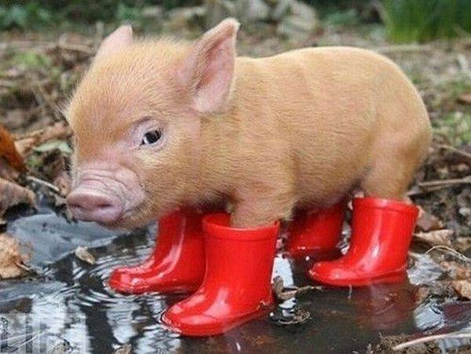
Animals put on

Slide 6
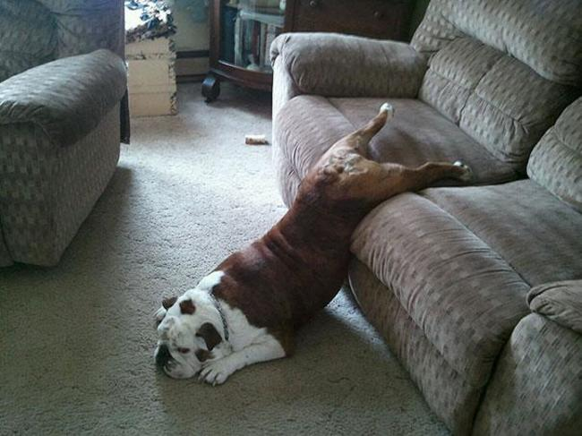
Animals get off

