Slide 1
Fishing
Pronouns

Slide 2
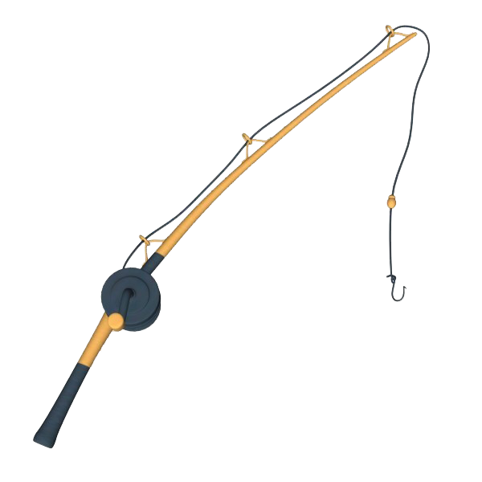
She is going fishing.

Slide 3
She is fishing.

Slide 4
She caught a fish.

Slide 5
She is putting the fish in the net.

Slide 6
He is going fishing.

Slide 7
He is fishing.

Slide 8
He caught a fish.

Slide 9
He is putting the fish in the net.

