Slide 1
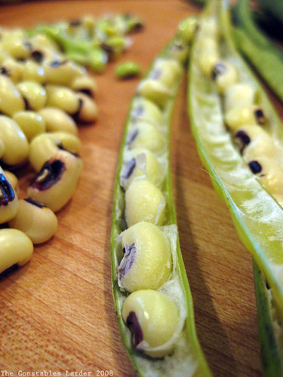
The Lucky Pea DebbieM

Slide 2
The Lucky Pea: black-eye peas

Slide 3
In many families, eating black-eyed peas on New Year's Day is thought to bring good luck in the new year.

Slide 4
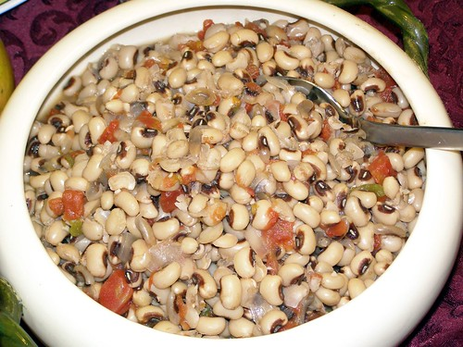
The peas, since they swell when cooked, symbolize good fortune.

Slide 5
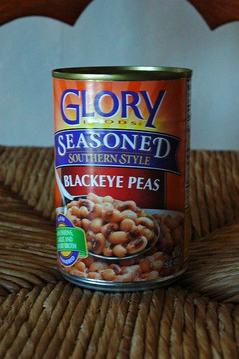
We can get black-eye peas in cans, dried, frozen or fresh.

Slide 6
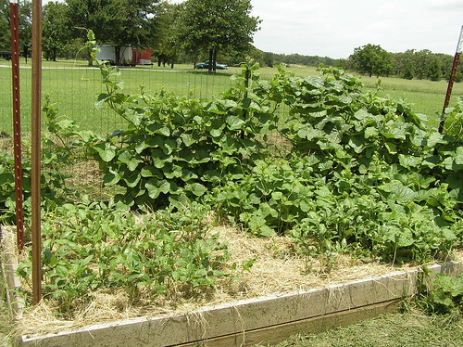
This plant likes hot weather. The plant does not need a lot of water.

Slide 7
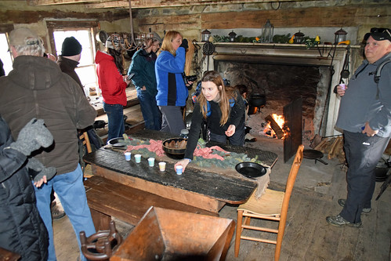
Families get together to make sure they eat black-eye peas. They want good things for the New Year.

Slide 8
Do you eat it for New Year's Day?

