Slide 1
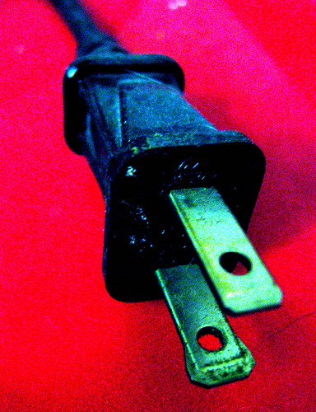
Why Do We Need Electricity? Regan Hawkins

Slide 2
Turn on the electricity!

Slide 3
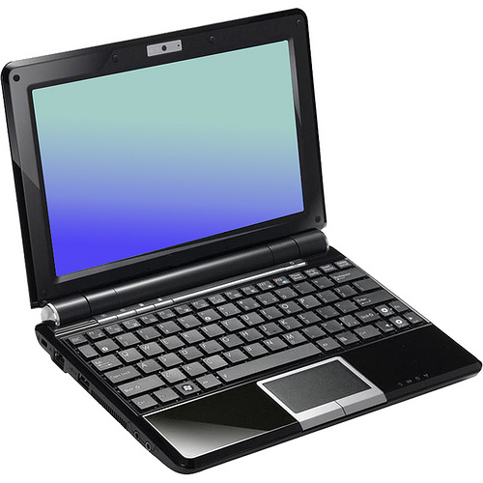
The computer we use at school needs electricity.
Turn it on!

Slide 4
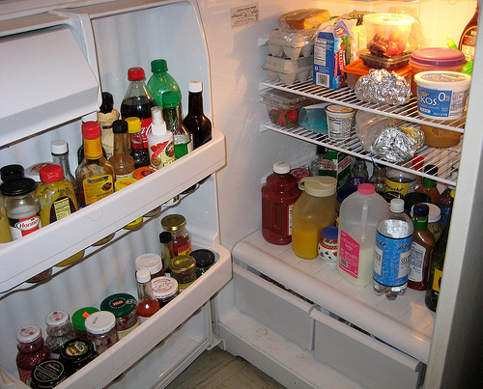
Our refrigerator uses electricity to keep food cold!
Turn it on!

Slide 5
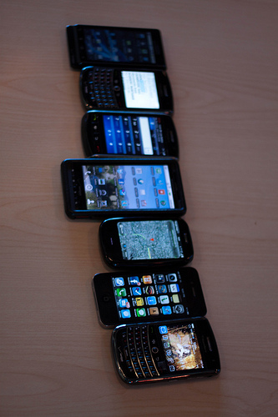
We need electricity to power our cell phones.
Turn it on!

Slide 6
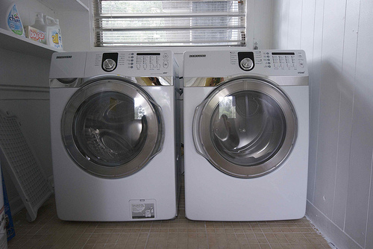
When we clean our clothes in the washer and dryer, we need electricity.
Turn it on!

Slide 7
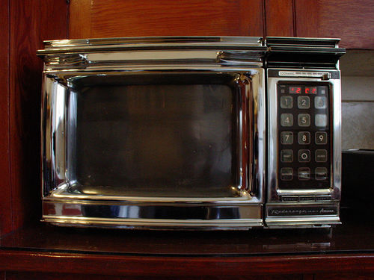
We use electricity when we cook our food in the microwave.
Turn it on!

Slide 8
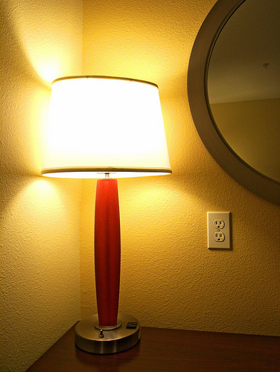
Lamps and lights use electricity.
Turn it on!

Slide 9
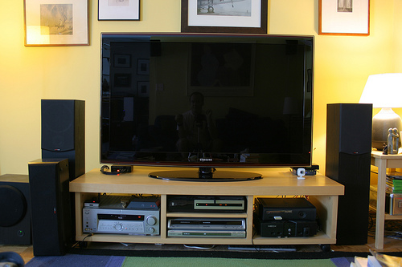
We need electricity to watch our favorite shows on TV!
Turn it on!

