Slide 1
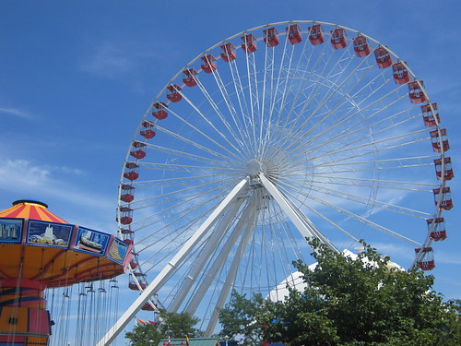
Amusement at the Park DebbieM

Slide 2
There are big rides that turn.

Slide 3
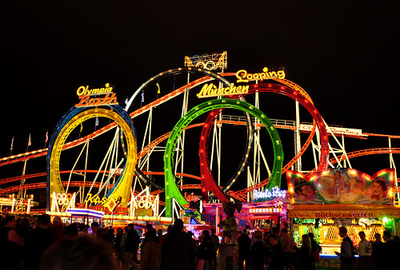
Lights turn on.

Slide 4
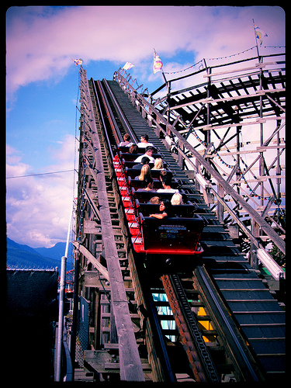
Some rides go up slow.

Slide 5
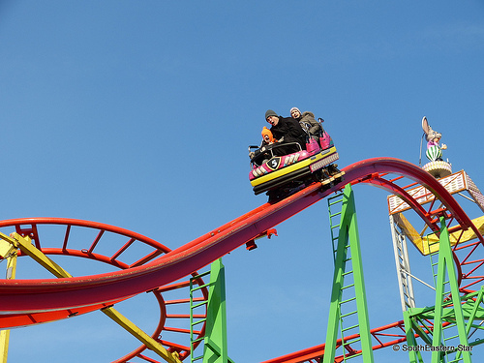
Some rides go down fast.

Slide 6
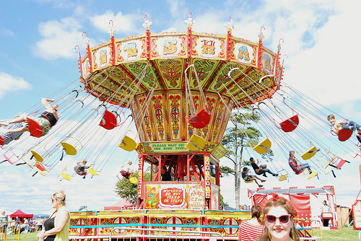
Rides go fast and out.

Slide 7
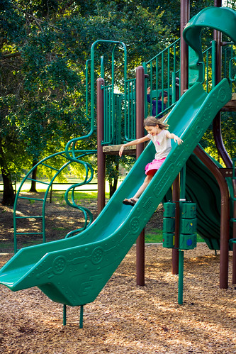
At my park, I go down fast.

Slide 8
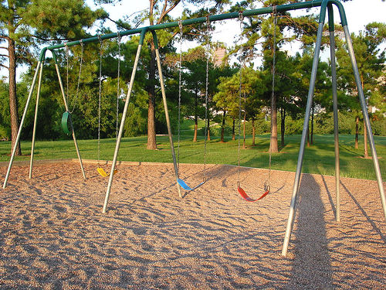
My swings go up and down.

