Slide 1
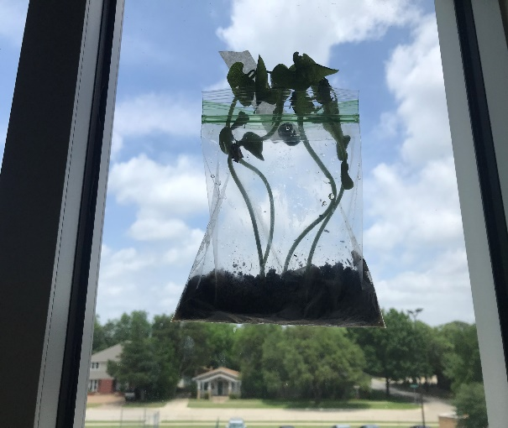
WATCH OUR GARDEN GROW

Slide 2
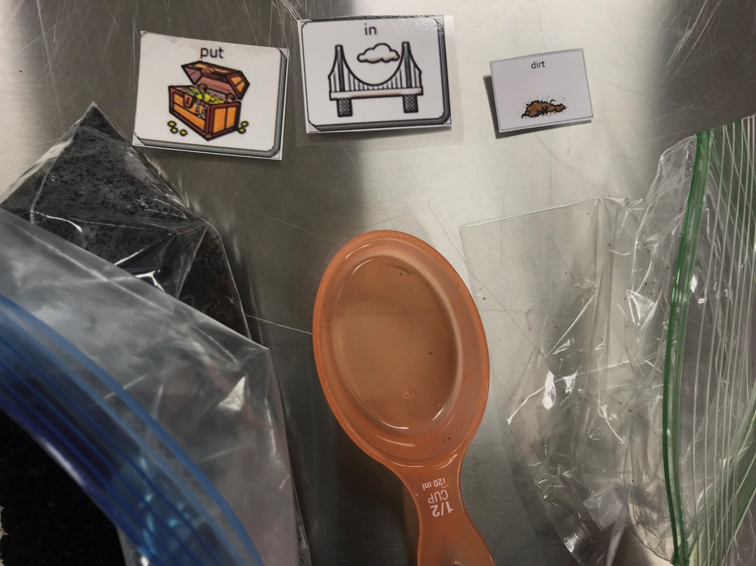
Put in dirt.

Slide 3
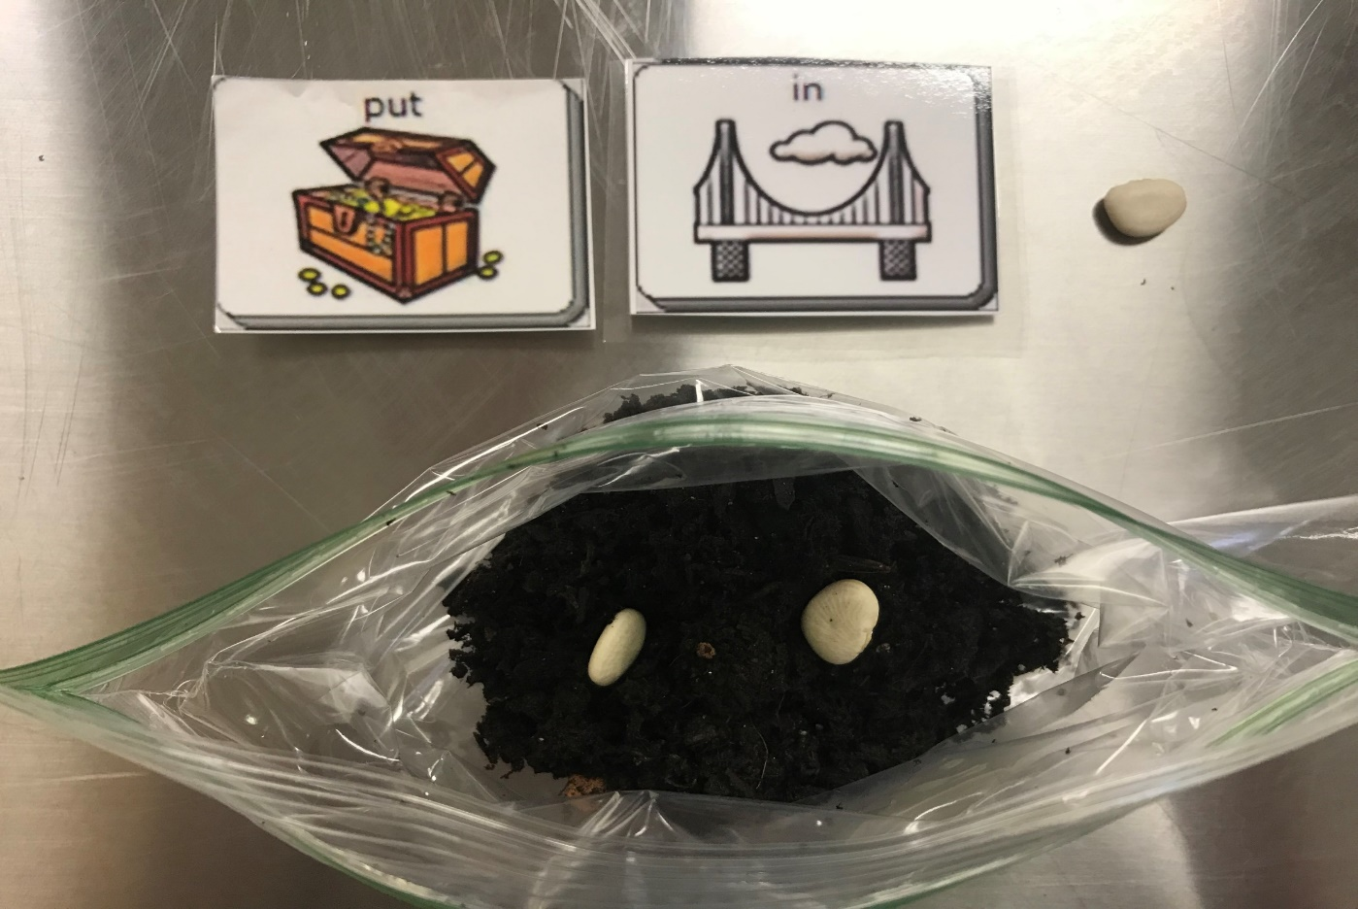
Put in seed.

Slide 4
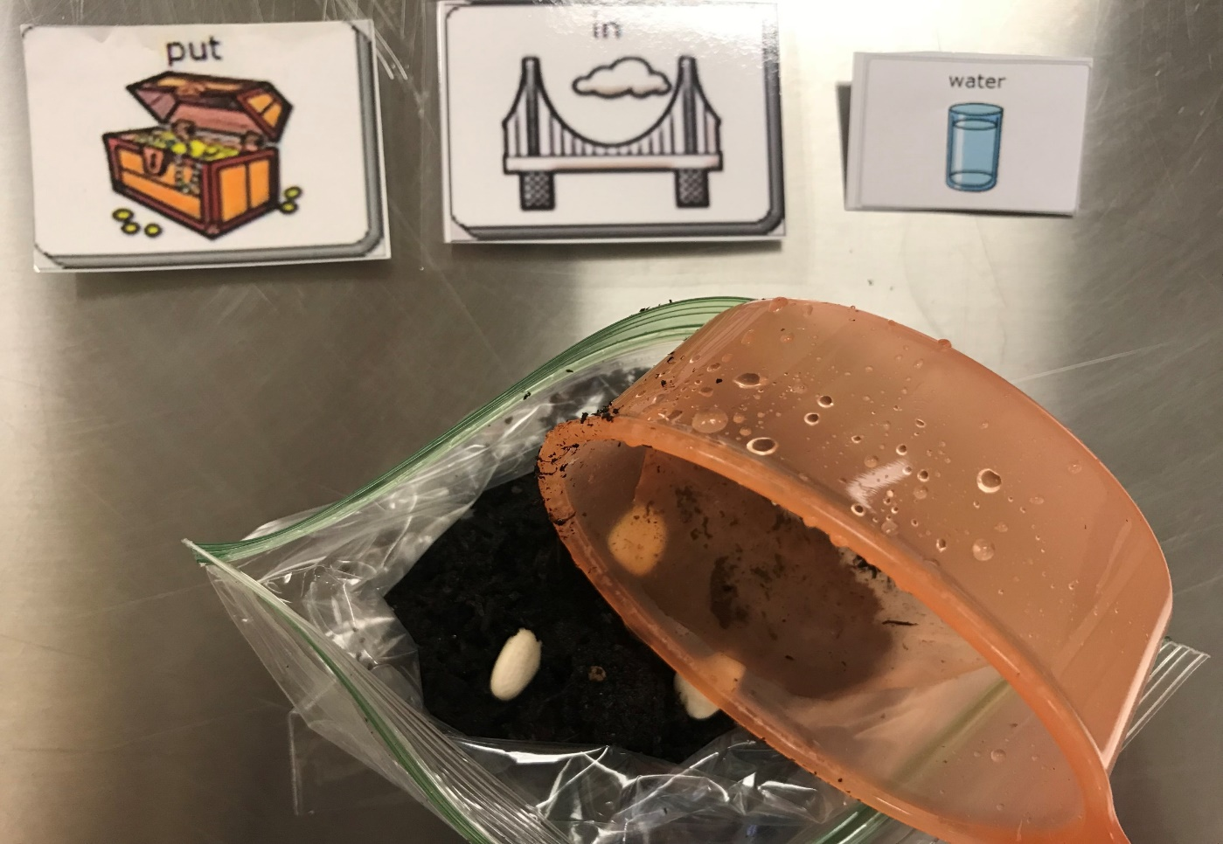
Put in water.

Slide 5
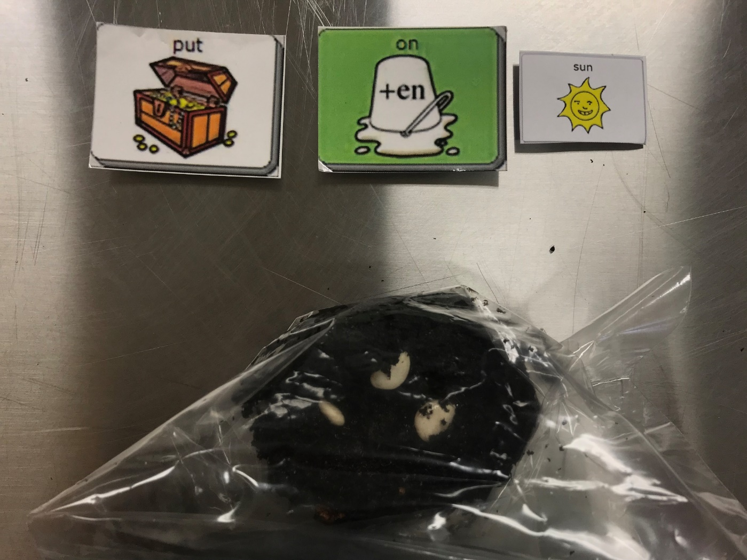
Put on sun.

Slide 6
Put on sun. Watch.

