Slide 1
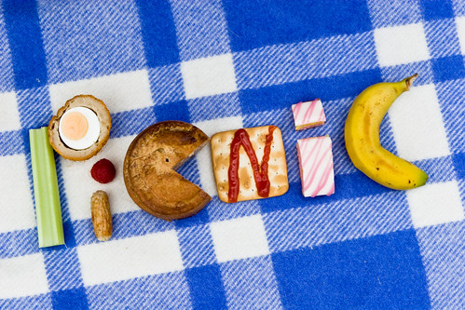
Summer Time DebbieM

Slide 2
Vamos a comer fuera. Let's go eat out.

Slide 3
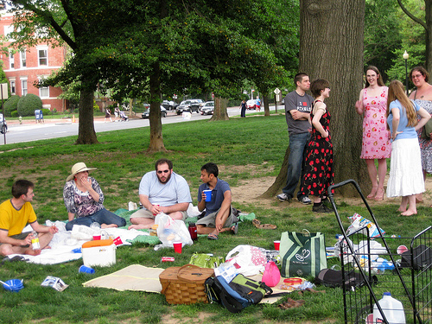
Todo ir comer fuera. All go eat out.

Slide 4
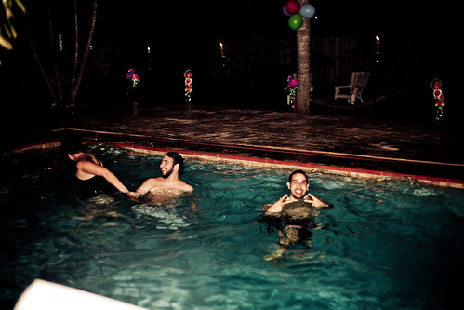
Bueno en aqua. Fun in the water.

Slide 5
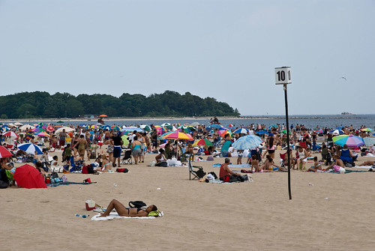
Todo fuera el aqua. All out of the water.

Slide 6
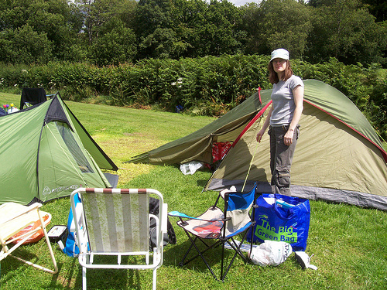
Vamos a ir a jugar y dormir. Let's go out to play and sleep.

Slide 7
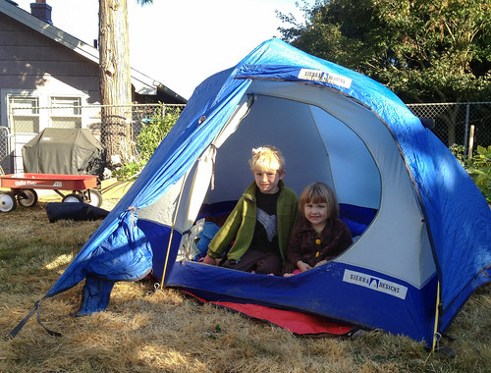
A mi casa. At my house.

Slide 8
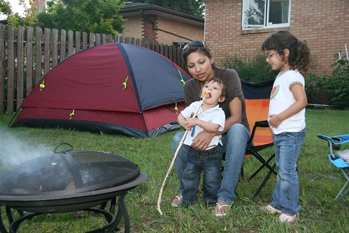
Vamos a comer y dormir a mi casa. Let's eat and sleep at my house.

