Slide 1
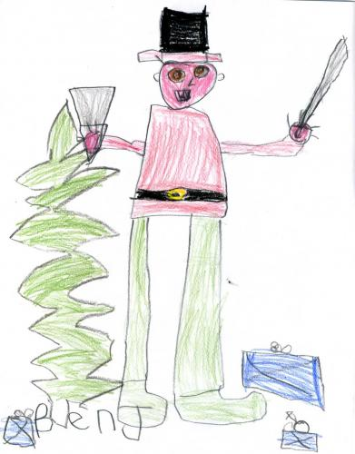
A Modern 12 Days of Christmas Mr. Matheson's Grade 1

Slide 2
A 1st grade version of the 12 Days of Christmas.

Slide 3
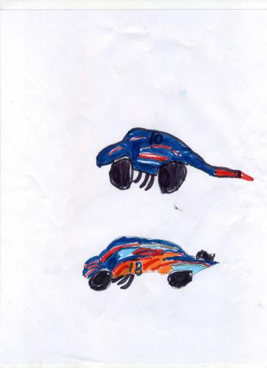
On the First Day of Christmas, Santa gave me a remote-control car.

Slide 4
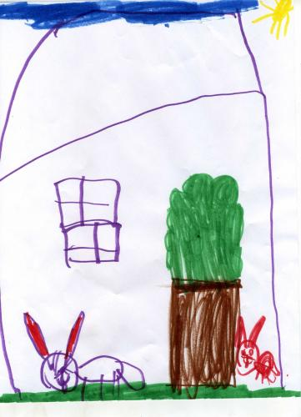
On the Second Day of Christmas, Santa gave me two "Littlest Pet Shop" toys.

Slide 5
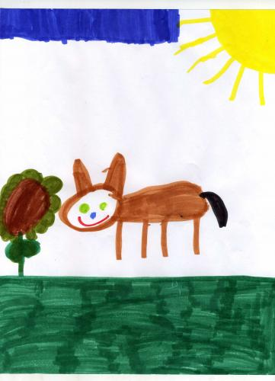
On the Third Day of Christmas, Santa gave me a cute teddy bear.

Slide 6
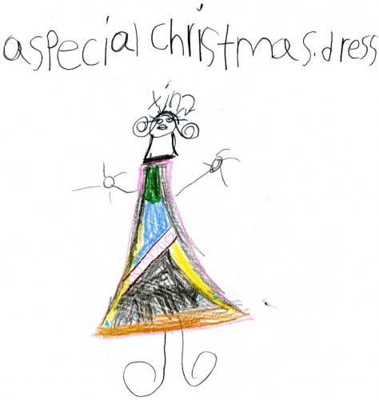
On the Fourth Day of Christmas, Santa gave me a special dress.

Slide 7
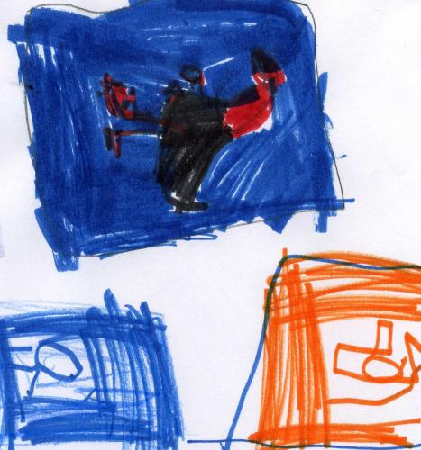
On the Fifth Day of Christmas, Santa gave me five DS games.

Slide 8
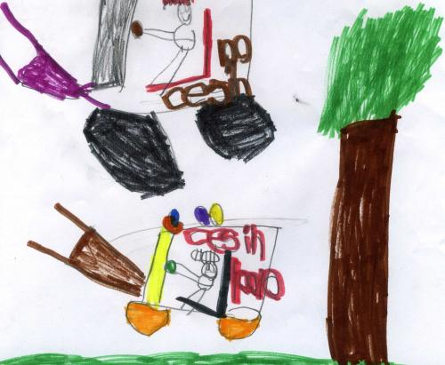
On the Sixth Day of Christmas, Santa gave me some toy tractors.

Slide 9
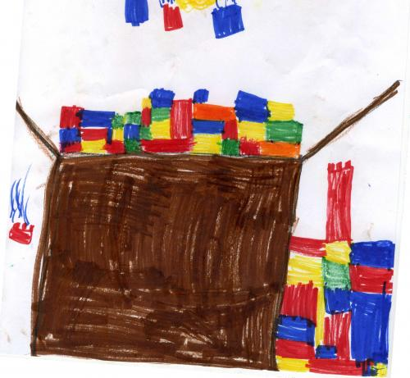
On the Seventh Day of Christmas, Santa gave me a big box of Legos.

Slide 10
On the Eighth Day of Christmas, Santa gave me a pullback 4-wheeler.

Slide 11
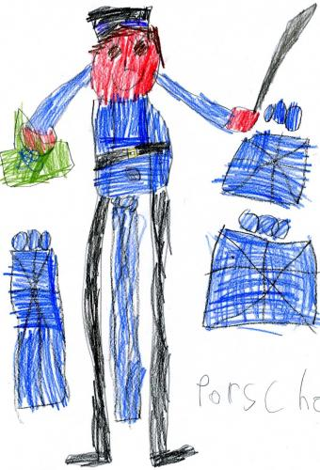
On the Ninth Day of Christmas, Santa gave me a colourful Nutcracker.

Slide 12
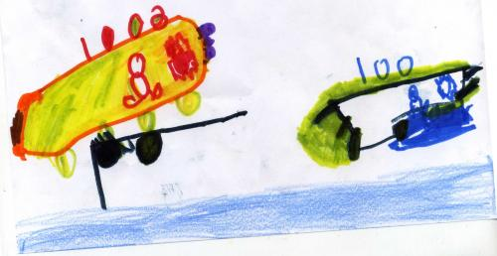
On the Tenth Day of Christmas, Santa gave me 10 Hot Wheels cars.

Slide 13
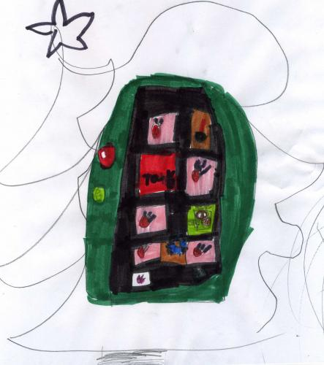
On the Eleventh Day of Christmas, Santa gave me an iPod with eleven songs.

Slide 14
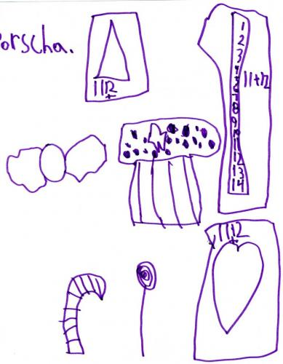
On the Twelfth Day of Christmas, Santa gave me twelve sweet treats.

Slide 15
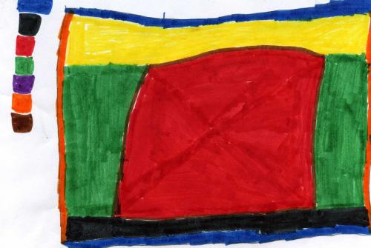
Happy Holidays!

