Slide 1
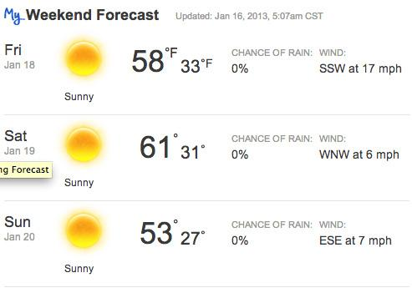
The Weather Outside C. Roberts
adapted by k cullen

Slide 2
I like to know the weather outside.

Slide 3
What is the weather outside?

Slide 4
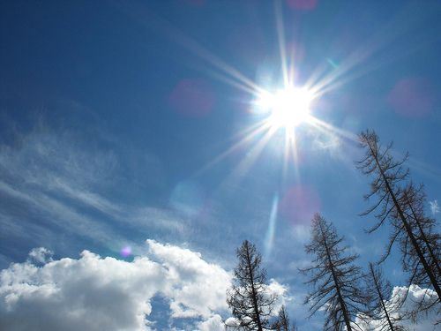
Is it sunny outside?

Slide 5
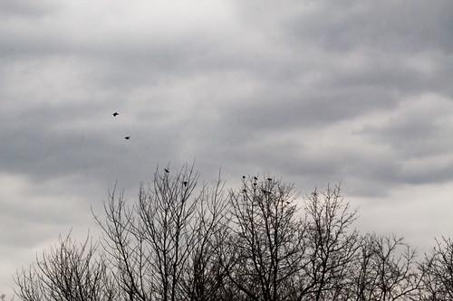
Is it cloudy outside?

Slide 6
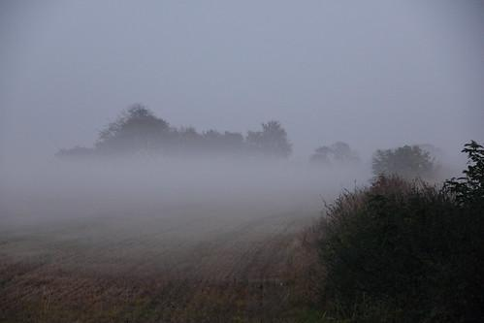
Is it foggy outside?

Slide 7
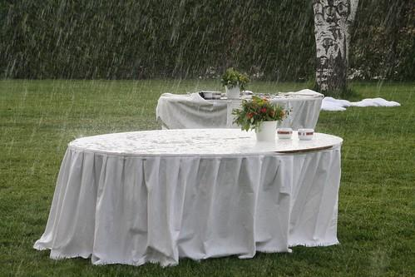
Is it raining outside?

Slide 8
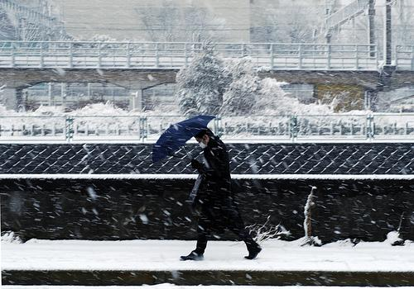
Is it snowing outside?

Slide 9
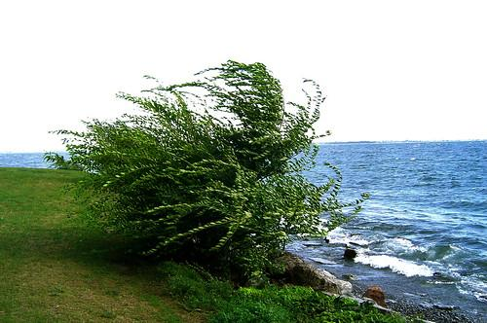
Is it windy outside?

Slide 10
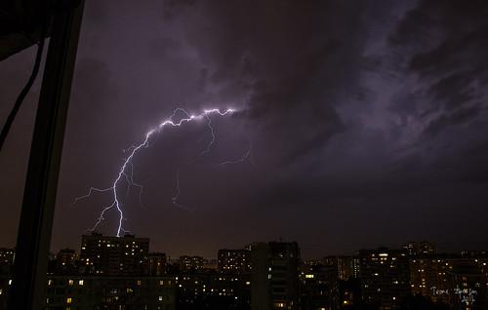
Is it stormy outside?

Slide 11
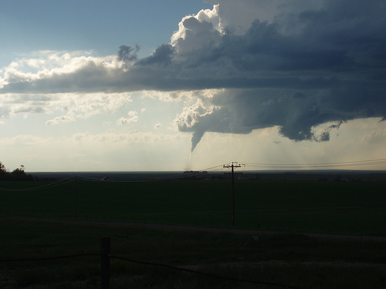
Is there a tornado outside?

Slide 12
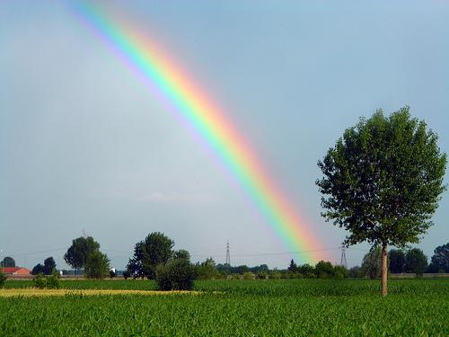
Is there a rainbow outside?

Slide 13
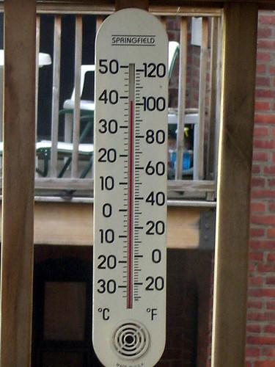
Is it hot outside?

Slide 14
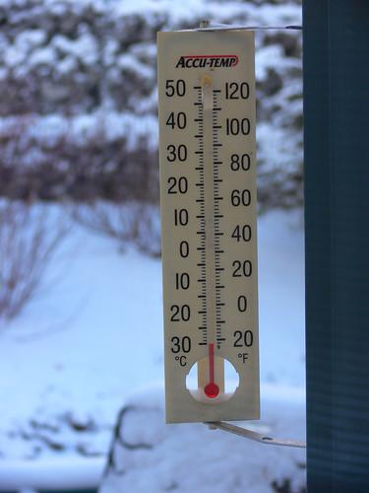
Is it cold outside?

Slide 15
The weather is:

Slide 16
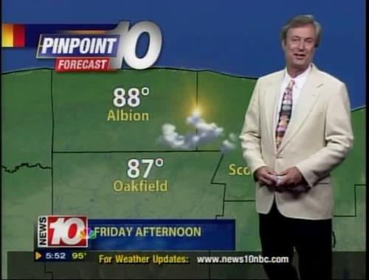
I am a weather reporter.

