Slide 1
YES! Conference Travel
Amy Townsend
August 4, 2022

Slide 2
Where to Find Travel Information

Slide 3
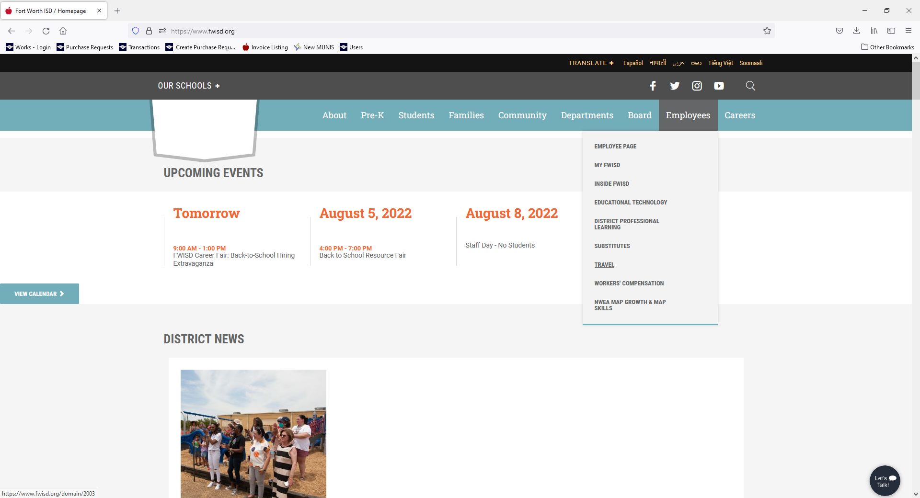
On the FWISD home page, Select Employees
Then Travel

Slide 4
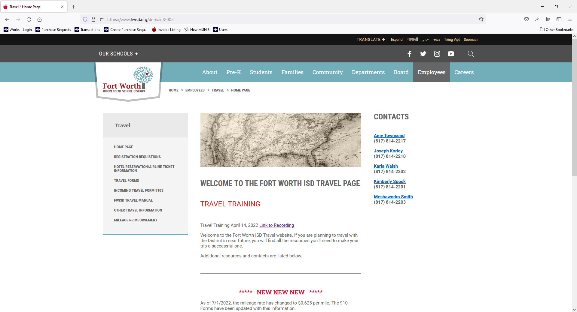
Select Travel Forms to find the 910 Form

Slide 5
Filling out the 910 Form

Slide 6
Meal Calculator
Meal Calculator
Go the GSA Rates tab
Find the State and City traveling to
If the City and State are not listed, use the Standard CONUS Rate or Standard Texas Comptroller’s Rate
Enter the M&IE Rate into the Meal Per Diem Rate Line
Enter the dates of travel under Dates
Place an X next to any meals that are provided by the conference/class/hotel – continental breakfast is considered a meal
Meals will calculate automatically and be carried over to the Cost Estimator

Slide 7
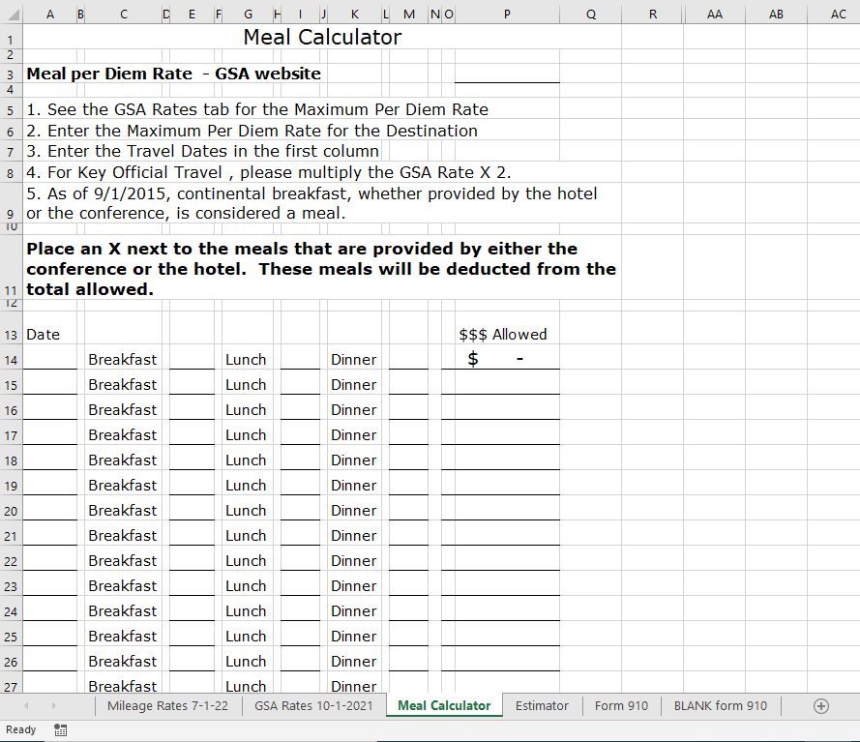
To get the GSA Per Diem Rate, go to the GSA Rates tab

Slide 8
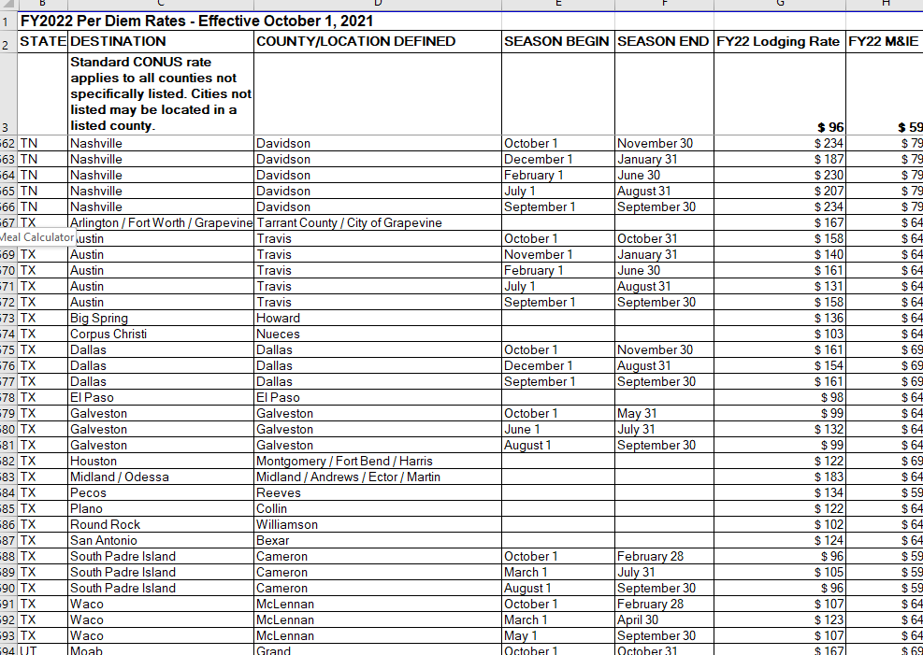
GSA Per Diem Rates
If City/County are not listed, use the Standard CONUS Rate
The M&IE Rate will be used as the Meal Rate on the Meal Calculator
Find the State and City (or County) you are traveling to

Slide 9
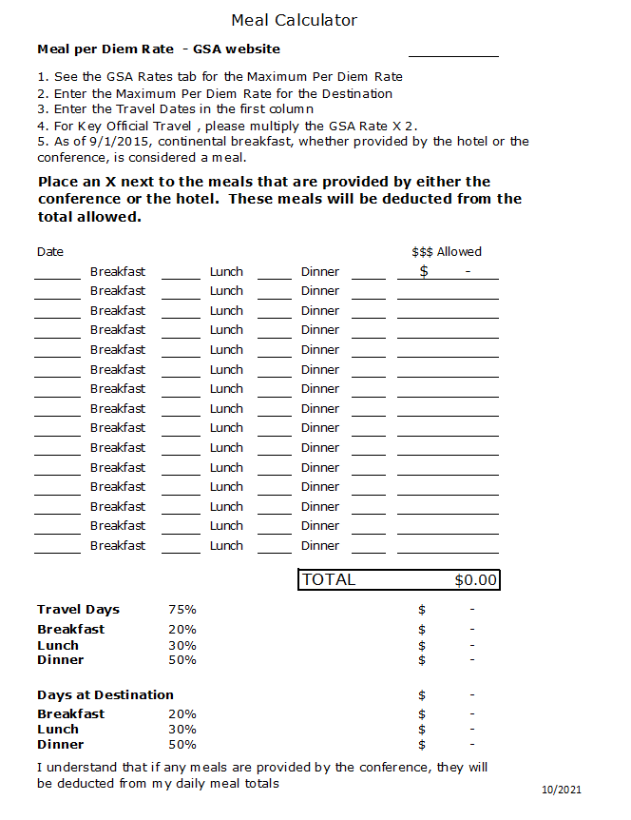
Meal Calculator
Type in the GSA Per Diem Rate
Enter the Dates of Travel
Once Date is entered, the daily allowable rate will calculate in the $$$ Allowed column
Total Meals Allowed will calculate automatically and fill in the cost estimator
Print page to attach with 910 Form
Put an X next to any meal that has been provided by the conference, class or hotel.

Slide 10
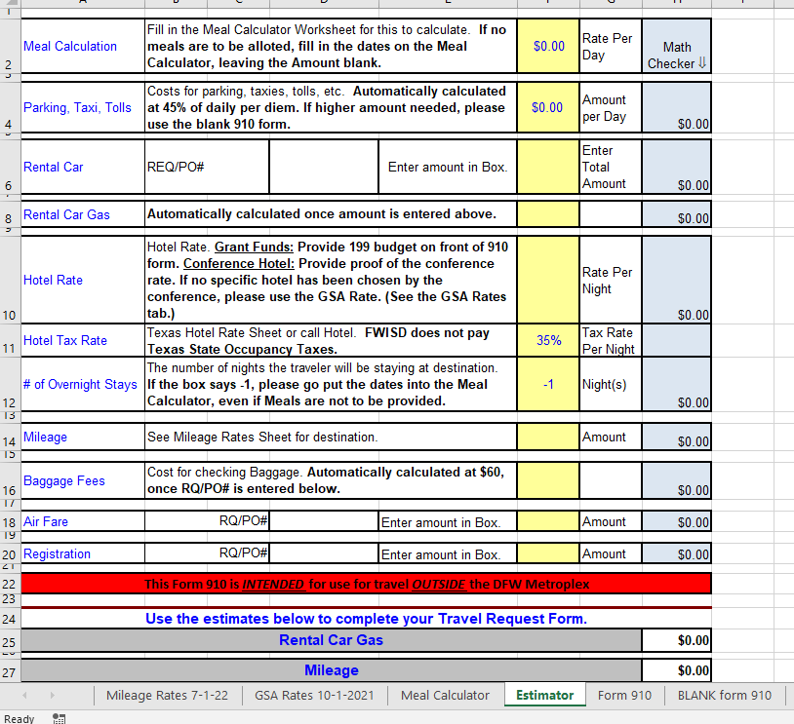
After filling out the Meal Calculator, Select the Estimator tab

Slide 11
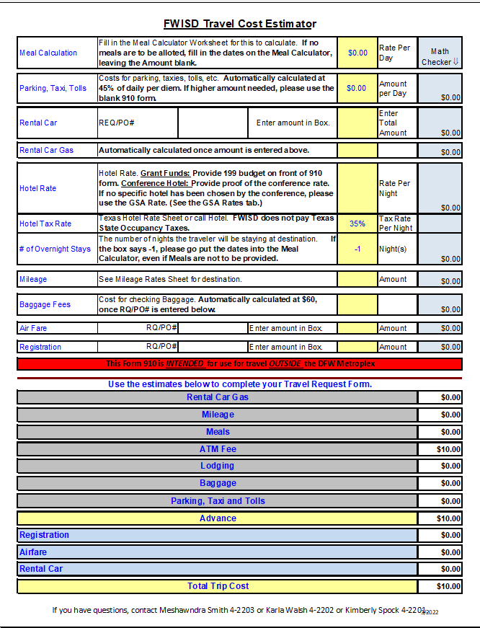
Cost Estimator
Uses Meal Calculator
Automatically Calculates
Automatically Calculates when the Airfare RQ/PO number is entered.

Slide 12
Parking, Taxi and Tolls
Incidentals: Parking, Taxi and Tolls
This is automatically calculated. If not used, will go back into your budget
At hotel, conference, etc
If the amount needed is higher than the rate calculated, either
White out the amount and write the correct amount in, or
Use the BLANK 910 form

Slide 13
Rental Cars
Rental Car
Please contact Kaleisa Jackson for Rental Car information
Please enter a RQ if you are going to rent a car
Enter the RQ/PO number on the Estimator – it will be carried over to the 910 form
Rental Car gas is automatically calculated once a RQ/PO number is added to the Estimator

Slide 14
Hotel
Hotel
Enter the hotel rate per night
If utilizing Grant funds to travel, the maximum allowable hotel rate that can be paid by the Grant is the GSA rate
199 Budget MUST be included on 910 Form for ALL grant travel
Local (199) funds may be used for the portion that is over the GSA rate, if any (Only allowed for hotels at the conference rate)
Conference hotel rate (from the conference) information MUST be provided with the 910

Slide 15
Hotel
In the event that a conference hotel rate exceeds the allowable rate, travelers are required to reimburse the District the difference between the hotel rate and the allowable rate if conference hotel rate confirmation documentation is not provided to the Purchasing department.
From the Travel Manual:
Hotel advance/reimbursement shall be for actual conference/convention rates at designated conference/convention hotels or for the most reasonable accommodations available pursuant to District practices and procedures and in accordance with the Texas Comptroller of Public Accounts (Texas Mileage Guide).
Unauthorized or disapproved costs and expenses incurred by an employee become the sole responsibility of that employee and shall not be paid or reimbursed by the District. The final approval or disapproval of the business office may be reviewed by the Superintendent or designee(s).

Slide 16
Hotel
Example: The traveler is attending a conference in Houston:
GSA Rate – federal/state government rate = $135
Conference Rate – rate contracted by the conference/convention with a hotel = $215
Rate Paid – the amount over the maximum documented conference hotel rate = $265
If the traveler does not provide conference/convention documentation, the traveler will owe for the amount over the GSA Rate - $80 + $50 per night plus applicable taxes. If it is a documented conference/convention hotel, the traveler will owe $50 per night plus applicable taxes.

Slide 17
Enter the nightly rate of the hotel room
# of Overnight Stays will calculate automatically once the Meal Calculator Dates are filled in.

Slide 18
Mileage
Mileage
$0.625 / Mile
To/From Airport
$31.43 to DFW
$43.20 to Love Field

Slide 19
Go to the Mileage Rates tab

Slide 20
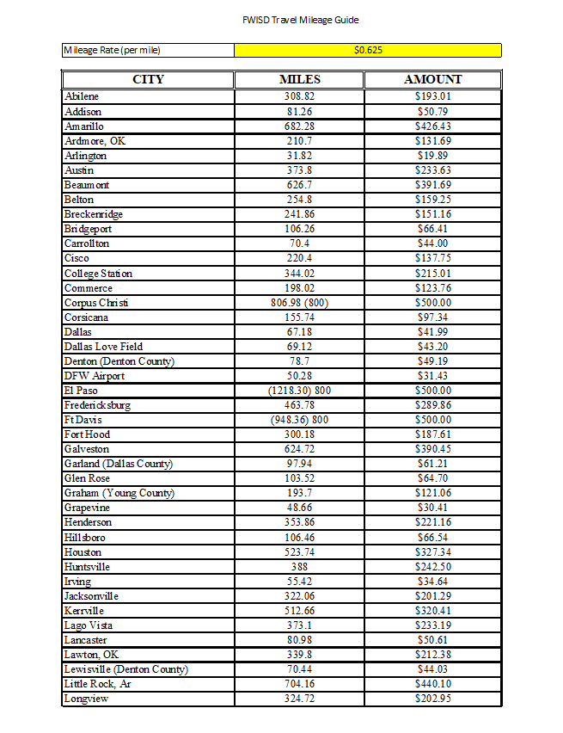
Use the Amount Column on the Estimator
If a city is not listed, please contact Purchasing for more assistance

Slide 21
Baggage Fees
Baggage Fees
Automatically calculated once a RQ/PO number is added for the flights

Slide 22
Airfare
Air Fare
Processed via RQ in MUNIS
Enter the RQ or PO number (if converted)
Enter the amount of the Air Fare – it will NOT be advanced to the traveler

Slide 23
Registration
Registration
Processed via RQ in MUNIS
Enter the RQ or PO number (if converted)
Enter the amount of the Conference/Class – will not be advanced to traveler
If paying on site, type Paying on Site in RQ/PO box on Estimator
If paid out of pocket, type Reimburse in the RQ/PO box on Estimator

Slide 24
Travel Request Form 910

Slide 25
Filling in the Travel Request Form 910
It is important that all sections are filled out completely and correctly
Forms filled out incorrectly and forms with missing information will cause delays in processing
Figures from the Estimator will automatically populate on the Form 910

Slide 26
Filling in the Travel Request Form 910
Information to include with the 910 form
Itinerary
Registration Form
Cost Estimator(Cost Estimator/Travel Form 910)
Meal Calculator(Cost Estimator/Travel Form 910)
Mileage Rate sheet (Cost Estimator/Travel Form 910)
GSA Per Diem Rates (Cost Estimator/Travel Form 910)
Conference Hotel/Hotel Rate Information
Conference Agenda

Slide 27
Filling in the Travel Request Form 910
Traveler Information
Name of Traveler – ensure the name is spelled correctly and the traveler’s correct name is used, no nick names
SS# (Last 4) – this is important to ensure we have the correct information for the person traveling, i.e. address, Social Security Number, location
Employee ID
School/Department
Traveler Signature and Date
To be signed by the traveler once the form has been printed
Leave the Travel No. blank

Slide 28
Filling in the Travel Request Form 910
Travel Information
Title of Traveler
Destination (City, State, Country)
Leave Date and Return Date
Name of Person filling out the 910 form and Phone number
For questions or problems
Conference/Class Name

Slide 29
Filling in the Travel Request Form 910
Travel Information
Budget Account Numbers
Ensure the Budget number is correct and complete
Ensure Budget number is strung
Ensure Funds are available in the Budget number
If traveling utilizing Grant funds, please include a Local (199) budget
Amount – only needs to be filled in if more than one budget number is being used
Substitute Required – circle yes or no
Circle, if any funds from other organization
Name of other organization

Slide 30
Filling in the Travel Request Form 910
Travel Approval Signatures
Follow the route prescribed by the Leadership Team
Check with your director to determine the correct route

Slide 31
Filling in the Travel Request Form 910
Travel Expenses
Will automatically populate from Cost Estimator
Will not allow you to make changes
For specific changes where costs will be different from the Estimator, please use the Blank Travel Request Form 910
Or you can white out the item and write the new amount in
Only field you can make changes to is OTHER – for costs not adequately funded
Add description of what will be purchased
Add amount in the Est. Cost field

Slide 32
Student Travel Request Form 910

Slide 33
Student Travel
Filling out the Student Travel Request Form 910 is basically the same as filling out the Employee Travel Request Form 910
A 910 is NOT filled out for each student traveling – only for the FWISD employee(s) traveling
It is our Recommendation that all student monies are handled by one person
There are two changes
Number of People Traveling – which includes both students and sponsors
Number of Rooms Planned – to estimate the hotel cost by the night and number of rooms

Slide 34
Airline Ticket Requisition

Slide 35
Airfare is typically at its lowest price 21 days before the departure date. Ticket prices will increase again 14 days before departure and once again 7 days before. It is in the District’s best interest to purchase airfare as early as possible.

Slide 36
Filling in the Airline Ticket Requisition Form
You MUST have a RQ number before you email the Travel Agent
Traveler Name – as it appears on their Driver’s license
Traveler Date of Birth
Traveler Gender
Conference Dates
Conference Ending Time

Slide 37
Filling in the Airline Ticket Requisition Form
Select the airport
DFW or Love Field
Destination City and State
Preferred Seat Type
Window or Aisle
The District will not pay for upgraded seats, extended legroom, earlier boarding

Slide 38
Filling in the Airline Ticket Requisition Form
Departure Date
Return Date
Preferred Time to Leave
Morning, Afternoon or Evening
Traveler email address
Requisitioner email address

Slide 39
Filling in the Airline Ticket Requisition Form
If the traveler is planning on extending their stay for personal reasons
Indicate to the travel agent both the actual business dates and the personal dates
The travel agent will create two itineraries to document the price difference – if any
Please provide BOTH itineraries with the 910 form
If the price is higher, the traveler MUST pay FWISD for the additional cost prior to the trip

Slide 40
Airline Ticket Requisition
RQ should be in Status 2 – Created before contacting the travel agent
Commodity Code – 785 – Airline Ticket Purchase only
Vendor – 29444
Ship To – your campus/department
Vendor Sourcing Note – 383630

Slide 41
Airline Ticket Requisition
Using the Travel Reservation Form, contact the travel agency:
National Travel Systems
fwisd@nationaltravelsystems.com
fwisdsharedbox@nationaltravelsystems.com
(800) 542-0452
Email a copy of the conference agenda to the travel agent along with the Travel Reservation Formand attach it to the RQ
The travel agent will email the person making the requisition, the traveler and the Purchasing department with the itinerary – including the price of the ticket(s).

Slide 42
Airline Ticket Requisition
Use the itinerary information to complete the RQ
Add traveler name, dates of travel, destination city and state in the description
Create a separate line item for each traveler
Create a separate line item for the $112.79 overage allowance ($12.79 to cover the travel agent fee and $100 for any overages between the reservation date and the purchase date.)
Any portion of the $100 not utilized will go back into the budget
If $100 will not cover the price increase, the RQ will be rejected for funds to be added

Slide 43
Airline Ticket Requisition
Attach a copy of the itinerary and conference agenda to the paperclip
Check travel dates and times – make sure the traveler has approved the times of travel before completing the RQ
Release RQ for approval and ensure it is approved by the appropriate Budget Owner so it can be converted to a PO

Slide 44
Airline Ticket Requisition
The Purchasing Department will review the RQ for accuracy, convert it to a PO and transmit it directly to the travel agent.
NOTE: The travel agent WILL NOT actually purchase the ticket until they receive a PO from the Purchasing Department
After the travel agent has purchased the ticket, they will email the electronic ticket to the traveler. A courtesy copy will be sent to the requisitioner and the Purchasing Department.
Please check the itinerary
After you receive the converted PO message, please Receive on the PO in MUNIS.
A copy of the itinerary must be included with the traveler’s Travel Request Form 910.

Slide 45
Questions?
Amy Townsend
Amy.townsend@fwisd.org
817-814-2217

